Slide 1

Hooke’s law
Robert Hooke, in 1676, noted that for a spring, the extension was proportional to the load.
It is now more generally stated that in certain cases, the extension (Δx) is proportional to the load (F).

Slide 2

Hooke’s law
Hooke’s law holds true in some cases of:
Tensile forces (stretching forces)
and in some cases of
Compressive forces (squashing forces)

Slide 3
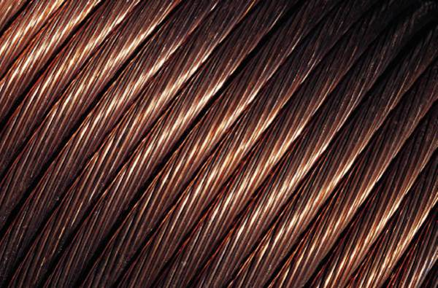
Hooke’s law
The constant of proportionality (k) is called the spring constant.

Slide 4

Hooke’s law
Rearranging the equation we get:
So the units will be:
N m⁻¹
^{Or}
^{N/m}

Slide 5
Hooke’s law
Example 1
A spring has a spring constant, k, of 10 Ncm⁻¹.
What will the extension be for a load of 50 N?

Slide 6
Hooke’s law
Example 2
A spring has a spring constant, k, of 5 Ncm⁻¹.
What load will cause it to stretch by 15 cm?

Slide 7
Hooke’s law
Example 3
A spring stretches 12 cm under a load of 36 N.
What is the spring constant of the spring?

Slide 8
Hooke’s law
Example 4
An unloaded spring is 12 cm long. If a weight of 15N is hung on the end of it, it extends to 18 cm long.
How long will the spring be, if a weight of 7.5 N is hung on it?
Using information from the first paragraph of the question we get:
Note Δx, is:
18 -12 = 6 cm

Slide 9
Hooke’s law
Example 4
An unloaded spring is 12 cm long. If a weight of 15N is hung on the end of it, it extends to 18 cm long.
How long will the spring be, if a weight of 7.5 N is hung on it?
Now using the information from the second paragraph:
So the length of the spring will be:
The original length + the extension

Slide 10
AS PHYSICS
Hooke’s law
Example 5
An aircraft is loaded with 100 kg of fuel. The compression oleos on the undercarriage undergo a compression of 2.5 mm.
What will the additional compression be, if the aircraft then takes on passengers of mass 250 kg?
Oleo
You can solve this problem using equations, as we have done in the previous questions and if you are happiest doing it that way, then carry on.
However, we can solve the problem just using proportionality.

Slide 11
AS PHYSICS
Hooke’s law
Example 5
An aircraft is loaded with 100 kg of fuel. The compression oleos on the undercarriage undergo a compression of 2.5 mm.
What will the additional compression be, if the aircraft then takes on passengers of mass 250 kg?
Oleo
100 kg causes a compression of 2.5 mm
So 1 kg will cause a compression of 2.5 mm / 100
So 250 kg will cause a compression of (2.5 mm / 100) x 250
Additional compression is 6.25 mm
Note that the total compression is 2.5 mm + 6.25 mm = 8.75 mm

Slide 12
AS PHYSICS
Hooke’s law
Example 6
What assumption have you made in each of these examples?
That the substances all obey Hooke’s law.
Force
Note that particularly for small extensions, there are many materials that obey Hooke’s law.
This is due to the nature of the intermolecular forces within the materials.
Separation

Slide 13
AS PHYSICS
Hooke’s law
Example 6
What assumption have you made in each of these examples?
That the substances all obey Hooke’s law.
Force
This area represents the atoms or molecules being pushed together.
There is a repulsive force between them.
Separation

Slide 14
AS PHYSICS
Hooke’s law
Example 6
What assumption have you made in each of these examples?
That the substances all obey Hooke’s law.
This area represents the atoms or molecules being pulled apart.
There is a force of attraction between them.
Force
Separation

Slide 15
AS PHYSICS
Hooke’s law
Example 6
What assumption have you made in each of these examples?
That the substances all obey Hooke’s law.
Force
At this point, there is no force so this is the equilibrium position.
Separation

Slide 16
AS PHYSICS
Hooke’s law
Example 6
What assumption have you made in each of these examples?
That the substances all obey Hooke’s law.
Force
Small displacements around this position are on a part of the curve which is almost straight.
This is the origin of Hooke’s law and the straight line graph that we get from it.
Separation

