Slide 1
I. Physical Properties
Ch. 14- Gases

Slide 2
A. Kinetic Molecular Theory
Particles in an ideal gas…
have no volume.
have elastic collisions.
are in constant, random, straight-line motion.
don’t attract or repel each other.
have an avg. KE directly related to Kelvin temperature.

Slide 3
B. Real Gases
Particles in a REAL gas…
have their own volume
attract each other
Gas behavior is most ideal…
at low pressures
at high temperatures
in nonpolar atoms/molecules

Slide 4
C. Characteristics of Gases
Gases expand to fill any container.
random motion, no attraction
Gases are fluids (like liquids).
no attraction
Gases have very low densities.
no volume = lots of empty space

Slide 5
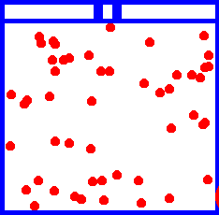
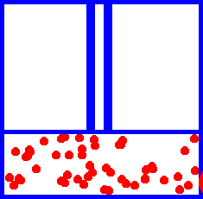
C. Characteristics of Gases
Gases can be compressed.
no volume = lots of empty space
Gases undergo diffusion & effusion.
random motion

Slide 6
D. Temperature
Always use absolute temperature (Kelvin) when working with gases.
ºF
-459
32
212
ºC
-273
0
100
K
0
273
373
K = ºC + 273

Slide 7
E. Pressure
Which shoes create the most pressure?

Slide 8
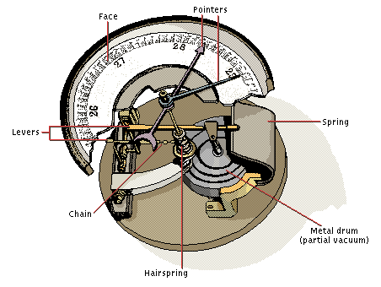
E. Pressure
Barometer
measures atmospheric pressure
Aneroid Barometer
Mercury Barometer

Slide 9
E. Pressure
Manometer
measures contained gas pressure
U-tube Manometer
Bourdon-tube gauge

Slide 10
E. Pressure
KEY UNITS AT SEA LEVEL
101.325 kPa (kilopascal)
1 atm
760 mm Hg
760 torr
14.7 psi

Slide 11
F. STP
STP
Standard Temperature & Pressure
0°C 273 K
1 atm 101.325 kPa
-OR-

