Slide 1
II. The Gas Laws
Ch. 14- Gases
V
T
P

Slide 2
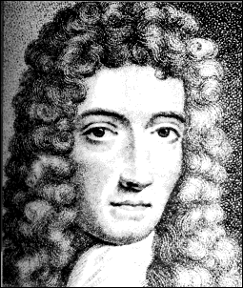
A. Boyle’s Law
PV = k
P
V

Slide 3
A. Boyle’s Law
The pressure and volume of a gas are inversely related
at constant mass & temp
PV = k
P
V

Slide 4
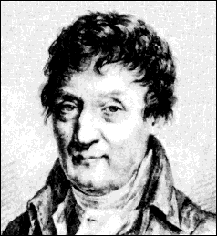
B. Charles’ Law
V
T

Slide 5
B. Charles’ Law
The volume and absolute temperature (K) of a gas are directly related
at constant mass & pressure
V
T

Slide 6
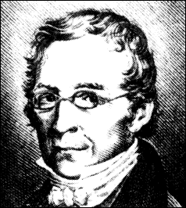
C. Gay-Lussac’s Law
P
T

Slide 7
C. Gay-Lussac’s Law
The pressure and absolute temperature (K) of a gas are directly related
at constant mass & volume
P
T

Slide 8
D. Combined Gas Law
P
T
V
T
PV
T
PV
= k
P₁V₁
T₁
P₂V₂
T₂
=
P₁V₁T₂ = P₂V₂T₁

Slide 9
E. Gas Law Problems
A gas occupies 473 cm³ at 36°C. Find its volume at 94°C.
CHARLES’ LAW
GIVEN:
V₁ = 473 cm³
T₁ = 36°C = 309K
V₂ = ?
T₂ = 94°C = 367K
T↑
V↑
WORK:
P₁V₁T₂ = P₂V₂T₁
(473 cm³)(367 K)=V₂(309 K)
V₂ = 562 cm³

Slide 10
E. Gas Law Problems
A gas occupies 100. mL at 150. kPa. Find its volume at 200. kPa.
BOYLE’S LAW
GIVEN:
V₁ = 100. mL
P₁ = 150. kPa
V₂ = ?
P₂ = 200. kPa
P↑
V↓
WORK:
P₁V₁T₂ = P₂V₂T₁
(150.kPa)(100.mL)=(200.kPa)V₂
V₂ = 75.0 mL

Slide 11
E. Gas Law Problems
A gas occupies 7.84 cm³ at 71.8 kPa & 25°C. Find its volume at STP.
COMBINED GAS LAW
P↑ T↓
V↓
GIVEN:
V₁ = 7.84 cm³
P₁ = 71.8 kPa
T₁ = 25°C = 298 K
V₂ = ?
P₂ = 101.325 kPa
T₂ = 273 K
WORK:
P₁V₁T₂ = P₂V₂T₁
(71.8 kPa)(7.84 cm³)(273 K)
=(101.325 kPa) V₂ (298 K)
V₂ = 5.09 cm³

Slide 12
E. Gas Law Problems
A gas’ pressure is 765 torr at 23°C. At what temperature will the pressure be 560. torr?
GAY-LUSSAC’S LAW
GIVEN:
P₁ = 765 torr
T₁ = 23°C = 296K
P₂ = 560. torr
T₂ = ?
P↓
T↓
WORK:
P₁V₁T₂ = P₂V₂T₁
(765 torr)T₂ = (560. torr)(309K)
T₂ = 226 K = -47°C

