Slide 1
III. Ideal Gas Law
Ch. 14 - Gases

Slide 2
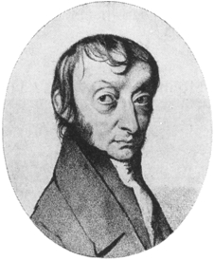
A. Avogadro’s Principle
Equal volumes of gases contain equal numbers of moles
at constant temp & pressure
true for any gas
V
n

Slide 3
A. Ideal Gas Law
Merge the Combined Gas Law with Avogadro’s Principle:
PV
T
V
n
PV
nT
= k
= R
UNIVERSAL GAS CONSTANT
R=0.0821 L⋅atm/mol⋅K
R=8.315 dm³⋅kPa/mol⋅K
You don’t need to memorize these values!

Slide 4
A. Ideal Gas Law
PV=nRT
UNIVERSAL GAS CONSTANT
R=0.0821 L⋅atm/mol⋅K
R=8.315 dm³⋅kPa/mol⋅K
You don’t need to memorize these values!

Slide 5
C. Ideal Gas Law Problems
Calculate the pressure in atmospheres of 0.412 mol of He at 16°C & occupying 3.25 L.
GIVEN:
P = ? atm
n = 0.412 mol
T = 16°C = 289 K
V = 3.25 L
R = 0.0821L⋅atm/mol⋅K
WORK:
PV = nRT
P(3.25)=(0.412)(0.0821)(289)
L mol L⋅atm/mol⋅K K
P = 3.01 atm

Slide 6
C. Ideal Gas Law Problems
Find the volume of 85 g of O₂ at 25°C and 104.5 kPa.
GIVEN:
V = ?
n = 85 g
T = 25°C = 298 K
P = 104.5 kPa
R = 8.315 dm³⋅kPa/mol⋅K
WORK:
85 g 1 mol = 2.7 mol
32.00 g
= 2.7 mol
PV = nRT
(104.5)V=(2.7) (8.315) (298)
kPa mol dm³⋅kPa/mol⋅K K
V = 64 dm³

