Slide 1
Elements and Compounds
Chapter 2.3

Slide 2
Substance or Mixture?
Remember that a mixture is a physical blend of 2 or more components- composition varies
  mixtures can be separated by physical changes
Substances- Have the same composition throughout- just one component
  Includes elements and compounds
  Cannot be physically separated
  In other words, boiling, filtering, distilling, or sifting will not separate the substance

Slide 3
Elements
An element is the simplest form of matter that has a unique set of properties.
  Can be an atom or a diatomic molecule
  Elements can be found on the periodic table
  Elements can’t be broken down physically or chemically
  An atom is the smallest unit of an element that retains that elements physical properties.

Slide 4
An element is a substance that is made from one kind of atom only. It cannot be broken down into simpler substances.
atom
atom
An element
An element

Slide 5
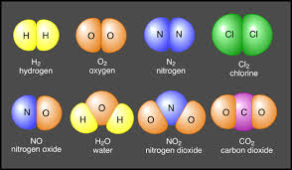
Molecules
  Molecule- 2 or more atoms bonded together
  Diatomic molecule- molecule containing 2 atoms of the same element
    There are 7 of them: H_{2,} N_{2,} O_{2,} Cl_{2,} F_{2,} Br_{2,} I₂

Slide 6
Compounds
A compound is a substance that contains two or more elements chemically combined in a fixed proportion
  Can be broken down by chemical means but not by physical means
  Fixed proportion- this means that the ratio of elements is the same in every particle of the compound
    H₂O - Water always contains 2 hydrogen atoms for every 1 oxygen atom
    CH₄ - Methane always contains 4 hydrogen atoms for every 1 carbon atom

Slide 7
Elements and Compounds
Gold (Au)
Silver (Ag)
Tin (Sn)
Lead (Pb)
Neon (Ne)
Mercury (Hg)
Sulfur (S)
Chlorine (Cl)
Fluorine (F)
Carbon Dioxide
Carbon Monoxide
Sodium Chloride
Hydrogen Peroxide
Water
Baking Soda
Ammonia
Rust
Sulfuric Acid

Slide 8
Material | Made up of: |  | Element or compound
Water | Hydrogen and Oxygen
Coal | Carbon
Carbon dioxide | Carbon and Oxygen
Oxygen | Oxygen
Chalk | Calcium, Carbon & Oxygen
Wax | Table salt | Sodium & Chlorine
 | Caffeine | Carbon, Hydrogen, Nitrogen & Oxygen

Slide 9
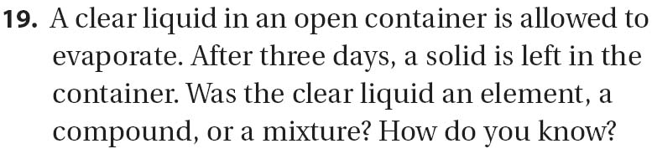
Problem Solving- Element or Compound

Slide 10
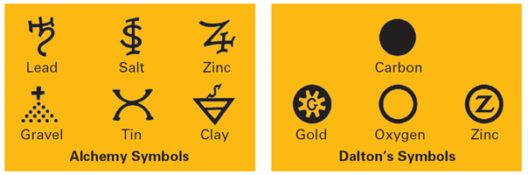
Chemical Symbols
We use Chemical Symbols to represent elements and combinations of chemical symbols to represent compounds
Previously used chemical symbols:

Slide 11
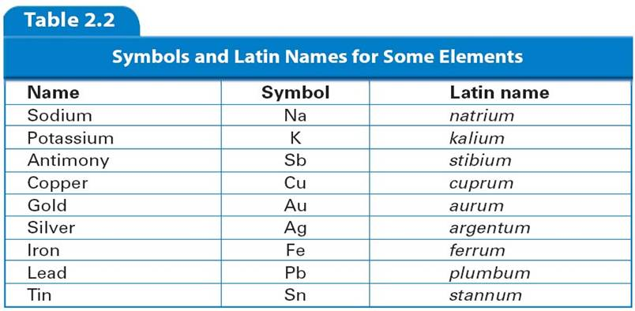
More Chemical Symbols

Slide 12
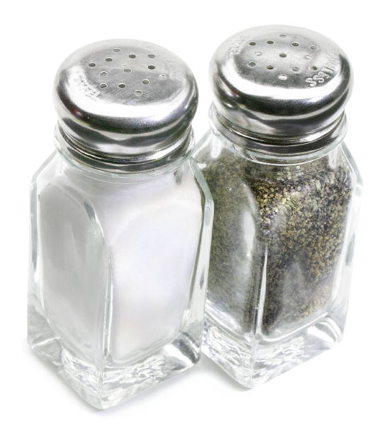
Chemical Reactions
A chemical reaction occurs whenever bonds between atoms and molecules are created or destroyed.
When a bond is created, the molecules form a new product.
Example: Sodium (Na) and Chlorine (Cl) react together by combining to form Sodium Chloride (NaCl).
Salt

Slide 13
Chemical Reactions
4. Example: When iron is left outside, it reacts with oxygen, and rust forms.
Example: Stomach acid digests food.

Slide 14
Is it a chemical reaction?
Are there bubbles being released when you add something to something else? (The matter may change phase and have new behavior.)
When mixing two solutions, does one solution change color?
Does the temperature change when you add one solution to another?
Does a precipitate form? A precipitate looks like colored sand, mud, dust, or snow forming in the solution. It lets us know new molecules were made.

Slide 15
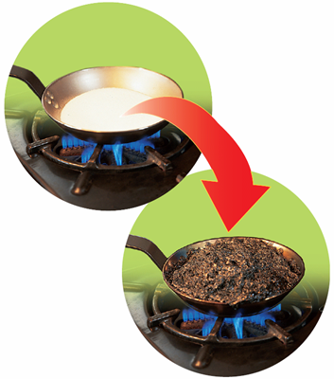
Breaking Down Compounds
A chemical change is a change that produces matter with a different composition than the original matter
    When table sugar is heated, it goes through a series of chemical changes. You can see the change as the sugar is burned.

Slide 16
Distinguishing Elements and Compounds
    The final products of these chemical changes are solid carbon and water vapor. The following diagram summarizes the process.

Slide 17
Properties of Compounds and Elements
    In general, the properties of compounds are quite different from those of their component elements.
    Sodium- explosive, soft, lustrous metal
    Chlorine- greenish yellow, poisonous gas
    Sodium Chloride- table salt!

Slide 18
Problem Solving- Element or Compound

Slide 19
Chemical Symbols
We use Chemical Symbols to represent elements and combinations of chemical symbols to represent compounds
Previously used chemical symbols:

Slide 20
More Chemical Symbols

