Slide 1
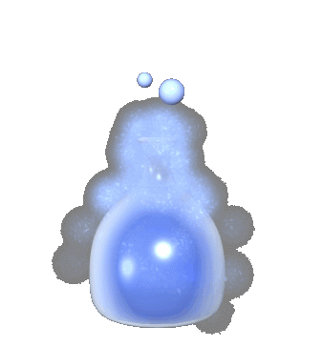
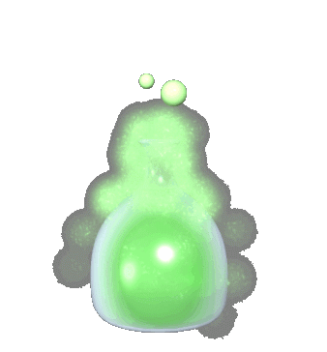
Physical and Chemical Changes

Slide 2
Physical Changes
Physical changes are changes that alter the size, shape, location or physical state of a substance but not its chemical state.

Slide 3
Don’t Use ‘Dem Big Words
Physical State-
Solid
Liquid
Gas
Substance-
Stuff… something… the item you are working with

Slide 4
So What Does That All Mean?
Ok… here’s the deal…
If the thing is still the same thing after it has been changed…
It’s a Physical Change.
Example… Boiling water
Boiling Water becomes
Water vapor
Water = water

Slide 5
Here’s An Example…
A physical change in a substance doesn't change what the substance is.
cutting paper –
physical change in the shape and size of the paper.
It is still paper!!!!!!

Slide 6
What Other Kinds of Changes Are Physical?
Cutting
Tearing
Shredding
Grinding
Shrinking
Enlarging
Change in Phase
Relocating
Dissolving
Rotating
Molding (shaping)

Slide 7
Chemical Changes
Chemical changes are changes that alter the chemical make up of the substance being changed.

Slide 8
Basically What You’re Telling Me Is…
If you end up with a chemical or chemicals that you did not start with,
It is a chemical change!!!!!!!

Slide 9
Here’s An Example…
Burning anything…
Once something burns, it can not burn again…
Burn a piece of wood and what do you have?
Ash… not wood. Ash cannot be burned again. It is a new substance!!!

Slide 10
Another Example Is…
Eating…
Now eating can change food both physically and chemically.
Chewing is Physical but…
Once your spit touches the food chemicals in the saliva begin to change the food chemically.

Slide 11
Signs That a Chemical Change has occurred
Creation of a gas (bubbles)
Creation or loss of heat
Fire
Rotting
Breaking down (decomposition)
Precipitation (Sour milk clumps)
Cooking
Rusting (oxidation)

