Slide 1
CHAPTER 25 Nuclear Chemistry
I
II
III
IV

Slide 2
A. Mass Defect
Difference between the mass of an atom and the mass of its individual particles.
4.00260 amu
4.03298 amu

Slide 3
B. Nuclear Binding Energy
Energy released when a nucleus is formed from nucleons.
High binding energy = stable nucleus.
E = mc²
E: energy (J)
m: mass defect (kg)
c: speed of light (3.00×10⁸ m/s)

Slide 4
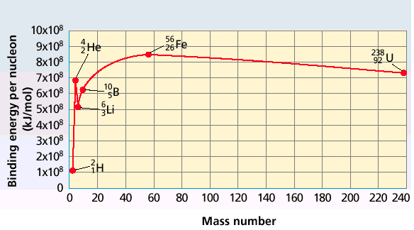
B. Nuclear Binding Energy
Unstable nuclides are radioactive and undergo radioactive decay.

