Slide 1
CHAPTER 25 Nuclear Chemistry
I
II. Radioactive Decay
II
III
IV

Slide 2
A. Types of Radiation
Alpha particle (α)
helium nucleus
paper
2+
Beta particle (β-)
electron
1-
lead
Positron (β+)
positron
1+
concrete
Gamma (γ)
high-energy photon
0

Slide 3
B. Nuclear Decay
Alpha Emission
parent
nuclide
daughter
nuclide
alpha
particle
Numbers must balance!!

Slide 4
B. Nuclear Decay
Beta Emission
electron
Positron Emission
positron

Slide 5
B. Nuclear Decay
Electron Capture
electron
Gamma Emission
Usually follows other types of decay.
Transmutation
One element becomes another.

Slide 6
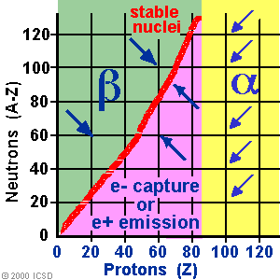
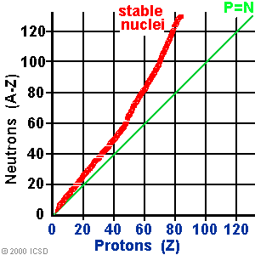
B. Nuclear Decay
Why nuclides decay…
need stable ratio of neutrons to protons

Slide 7
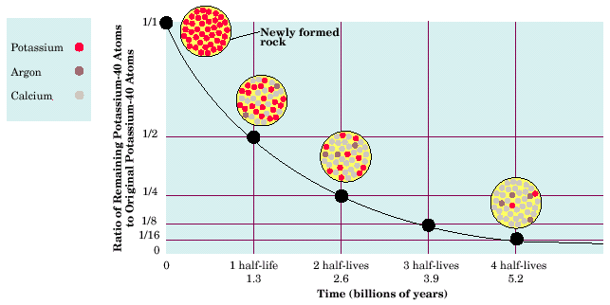
C. Half-life
Half-life (t_{½})
Time required for half the atoms of a radioactive nuclide to decay.
Shorter half-life = less stable.

Slide 8
C. Half-life
m_{f}: final mass
m_{i}: initial mass
n: # of half-lives

Slide 9
C. Half-life
Fluorine-21 has a half-life of 5.0 seconds. If you start with 25 g of fluorine-21, how many grams would remain after 60.0 s?
GIVEN:
t_{½} = 5.0 s
m_{i} = 25 g
m_{f} = ?
total time = 60.0 s
n = 60.0s ÷ 5.0s =12
WORK:
m_{f} = m_{i} (½)^{n}
m_{f} = (25 g)(0.5)¹²
m_{f} = 0.0061 g

