Slide 1
CHAPTER 25 Nuclear Chemistry
I
III. Fission & Fusion
II
III
IV

Slide 2
A. F ission
splitting a nucleus into two or more smaller nuclei
1 g of ²³⁵U = 3 tons of coal

Slide 3
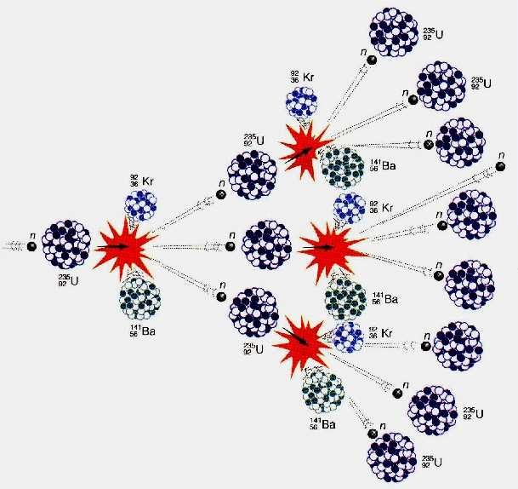
A. F ission
chain reaction - self-propagating reaction
critical mass - mass required to sustain a chain reaction

Slide 4
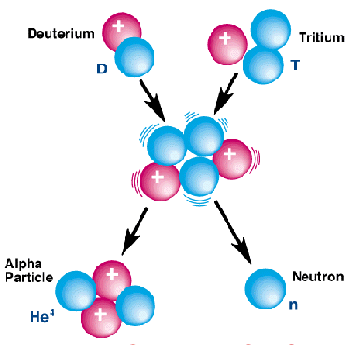
B. Fusion
combining of two nuclei to form one nucleus of larger mass
thermonuclear reaction – requires temp of 40,000,000 K to sustain
1 g of fusion fuel = 20 tons of coal
occurs naturally in stars

Slide 5
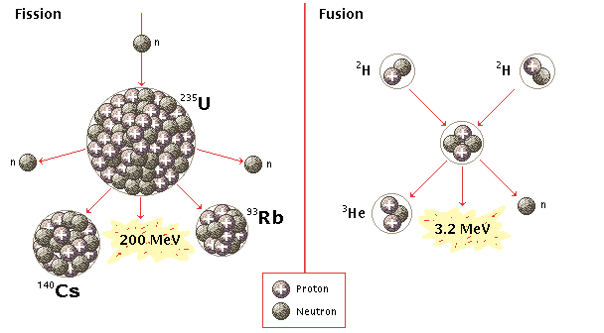
C. Fission vs. Fusion
FISSION
FUSION
²³⁵U is limited
danger of meltdown
toxic waste
thermal pollution
fuel is abundant
no danger of meltdown
no toxic waste
not yet sustainable

