Slide 1
Section 3.2 The International System of Units
OBJECTIVES:
List SI units of measurement and common SI prefixes.

Slide 2
Section 3.2 The International System of Units
OBJECTIVES:
Distinguish between the mass and weight of an object.

Slide 3
Section 3.2 The International System of Units
OBJECTIVES:
Convert between the Celsius and Kelvin temperature scales.

Slide 4
Error
Accepted value = the correct value based on reliable references
Experimental value = the value measured in the lab

Slide 5
Error
Error = accepted value – exp. value
Can be positive or negative
Percent error = the absolute value of the error divided by the accepted value, then multiplied by 100%
| error |
accepted value
% error =
x 100%

Slide 6
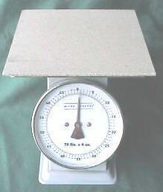
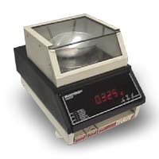
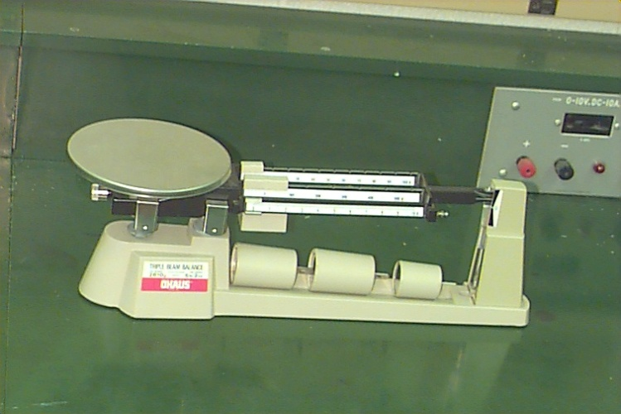
Why Is there Uncertainty?
Measurements are performed with instruments, and no instrument can read to an infinite number of decimal places
Which of the balances below has the greatest uncertainty in measurement?

Slide 7
International System of Units
Measurements depend upon units that serve as reference standards
The standards of measurement used in science are those of the Metric System

Slide 8
International System of Units
Metric system is now revised and named as the International System of Units (SI), as of 1960
It has simplicity, and is based on 10 or multiples of 10
7 base units, but only five commonly used in chemistry: meter, kilogram, kelvin, second, and mole.

Slide 9
The Fundamental SI Units (Le Système International, SI)

Slide 10
Nature of Measurements
Measurement - quantitative observation
consisting of 2 parts:
Part 1 – number
Part 2 - scale (unit)
Examples:
20 grams
6.63 x 10⁻³⁴ Joule seconds

Slide 11
International System of Units
Sometimes, non-SI units are used
Liter, Celsius, calorie
Some are derived units
They are made by joining other units
Speed = miles/hour (distance/time)
Density = grams/mL (mass/volume)

Slide 12
Length
In SI, the basic unit of length is the meter (m)
Length is the distance between two objects – measured with ruler
We make use of prefixes for units larger or smaller

Slide 13
SI Prefixes – Page 74 Common to Chemistry
Prefix | Unit Abbreviation | Meaning | Exponent
Kilo- | k | ^{thousand} | 10³
Deci- | d | ^{tenth} | 10⁻¹
Centi- | c | ^{hundredth} | 10⁻²
Milli- | m | ^{thousandth} | 10⁻³
Micro- | μ | ^{millionth} | 10⁻⁶
Nano- | n | ^{billionth} | 10⁻⁹

Slide 14
Volume
The space occupied by any sample of matter.
Calculated for a solid by multiplying the length x width x height; thus derived from units of length.
SI unit = cubic meter (m³)
Everyday unit = Liter (L), which is non-SI. (Note: 1mL = 1cm³)

Slide 15
Devices for Measuring Liquid Volume
Graduated cylinders
Pipets
Burets
Volumetric Flasks
Syringes

Slide 16
The Volume Changes!
Volumes of a solid, liquid, or gas will generally increase with temperature
Much more prominent for GASES
Therefore, measuring instruments are calibrated for a specific temperature, usually 20 ºC, which is about room temperature

Slide 17
Units of Mass
Mass is a measure of the quantity of matter present
Weight is a force that measures the pull by gravity- it changes with location
Mass is constant, regardless of location

Slide 18
Working with Mass
The SI unit of mass is the kilogram (kg), even though a more convenient everyday unit is the gram
Measuring instrument is the balance scale

Slide 19
Units of Temperature
Temperature is a measure of how hot or cold an object is.
Heat moves from the object at the higher temperature to the object at the lower temperature.
We use three units of temperature:
Fahrenheit
Celsius
Kelvin
(Measured with a thermometer.)

Slide 20
Units of Temperature
Celsius scale defined by two readily determined temperatures:
Freezing point of water = 0 ºC
Boiling point of water = 100 ºC
Kelvin scale does not use the degree sign, but is just represented by K
absolute zero = 0 K (thus no negative values)
formula to convert: K = ºC + 273

Slide 21
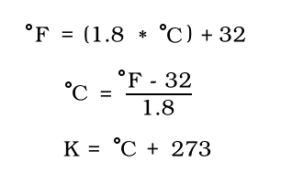
Important Equations

Slide 22
1. Define 0 C on the Kelvin Scale
2. Convert

Slide 23
Units of Energy
Energy is the capacity to do work, or to produce heat.
Energy can also be measured, and two common units are:
Joule (J) = the SI unit of energy, named after James Prescott Joule
calorie (cal) = the heat needed to raise 1 gram of water by 1 ºC

Slide 24
Units of Energy
Conversions between joules and calories can be carried out by using the following relationship:
1 cal = 4.18 J
(sometimes you will see 1 cal = 4.184 J)

