Slide 1
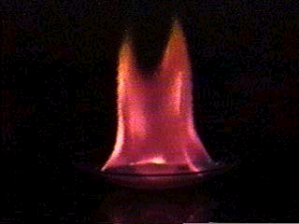
Waves & Particles
Ch. 5 - Electrons in Atoms

Slide 2
A. Waves
Wavelength (λ) - length of one complete wave
Frequency (ν) - # of waves that pass a point during a certain time period
hertz (Hz) = 1/s
Amplitude (A) - distance from the origin to the trough or crest

Slide 3
A. Waves
λ
crest
greater amplitude
(intensity)
A
origin
A
trough
λ
greater frequency
(color)

Slide 4
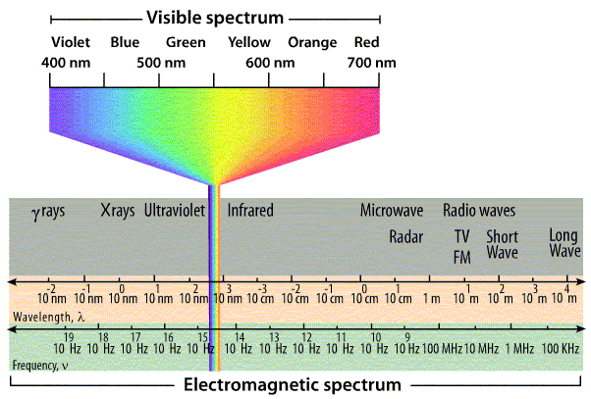
B. EM Spectrum
HIGH
ENERGY
LOW
ENERGY

Slide 5
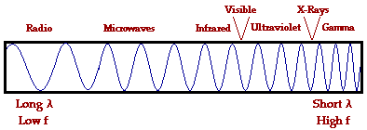
B. EM Spectrum
HIGH
ENERGY
LOW
ENERGY
R
O
Y
G.
B
I
V
red
orange
yellow
green
blue
indigo
violet

Slide 6
C. Quantum Theory
Ground State – When an electron is in it’s lowest possible energy.
Light emitted by an electron moving from a higher to a lower energy level has a frequency directly proportional to the energy change of the electron.

Slide 7
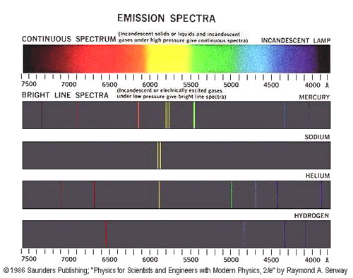
C. Atomic Emissions

Slide 8
B. EM Spectrum
Frequency & wavelength are inversely proportional
c = λν
c: speed of light (3.00 × 10⁸ m/s)
λ: wavelength (m, nm, etc.)
ν: frequency (Hz)

Slide 9
B. EM Spectrum
EX: Find the frequency of a photon with a wavelength of 434 nm.
GIVEN:
ν = ?
λ = 434 nm = 4.34 × 10⁻⁷ m
c = 3.00 × 10⁸ m/s
WORK:
ν = c
λ
ν = 3.00 × 10⁸ m/s
4.34 × 10⁻⁷ m
ν = 6.91 × 10¹⁴ Hz

Slide 10
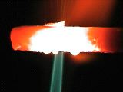
C. Quantum Theory
Planck (1900)
Observed - emission of light from hot objects
Concluded - energy is emitted in small, specific amounts (quanta)
Quantum - minimum amount of energy change

Slide 11
C. Quantum Theory
Einstein (1905)
Concluded - light has properties of both waves and particles
“wave-particle duality”
Photon - particle of light that carries a quantum of energy

Slide 12
C. Quantum Theory
Planck (1900)
vs.
Classical Theory
Quantum Theory

Slide 13
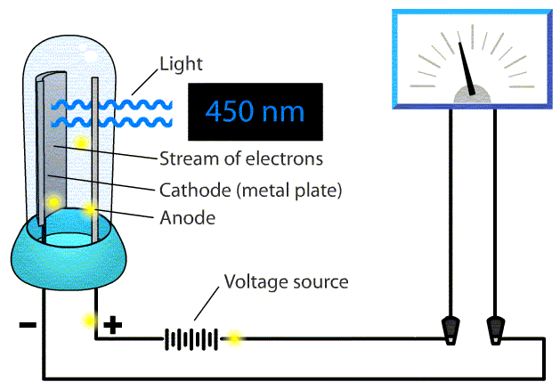
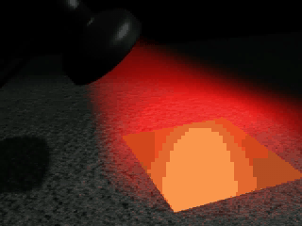
C. Quantum Theory
Einstein (1905)
Observed - photoelectric effect

Slide 14
C. Quantum Theory
The energy of a photon is proportional to its frequency.
E = hν
E: energy (J, joules)
h: Planck’s constant (6.6262 × 10⁻³⁴ J·s)
ν: frequency (Hz)

Slide 15
C. Quantum Theory
EX: Find the energy of a red photon with a frequency of 4.57 × 10¹⁴ Hz.
GIVEN:
E = ?
ν = 4.57 × 10¹⁴ Hz
h = 6.6262 × 10⁻³⁴ J·s
WORK:
E = hν
E = (6.6262 × 10⁻³⁴ J·s) (4.57 × 10¹⁴ Hz)
E = 3.03 × 10⁻¹⁹ J

