Slide 1
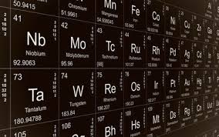
Chapter 6
The Periodic Table
6.1 Organizing the Elements
6.2 Classifying the Elements
6.3 Periodic Trends
6.1 - Organizing Elements

Slide 2
6.1 Organizing the Elements
Historical Development
Only a few elements have been known since ancient times
1700s
Scientists began to look for elements
Discovered 5 in one ten year period
Wanted a way to predict what they should look for
Used properties to sort elements into groups
Had various organization schemes

Slide 3
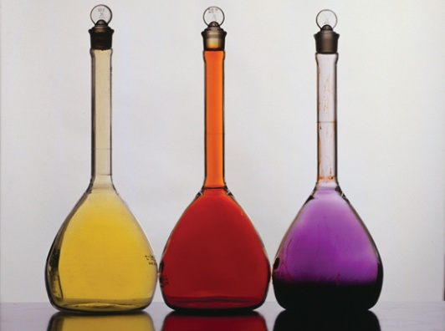
Searching for an Organizing Principle
In 1829, a German chemist, J. W. Dobereiner, published a classification system. In his system, the known elements were grouped into triads.
A triad is a set of three elements with similar properties.
The elements shown here formed one triad. Chlorine, bromine, and iodine may look different, but they have very similar chemical properties.
Found that the middle element in a triad had a mass midway between the other two

Slide 4
6.1 Organizing the Elements
Mendeleev
Wrote properties of each element on separate card
Moved them around until they made a pattern based on increasing atomic mass
Elements with similar properties appeared periodically
Was able to predict other elements that would be found
Lothar Meyer
Organized table like Mendeleev did
Didn’t publish it before Mendeleev published his

Slide 5
Medeleev’s Periodic Table
Mendeleev’s table allowed prediction of properties of unknown elements so scientists knew what to look for.

Slide 6
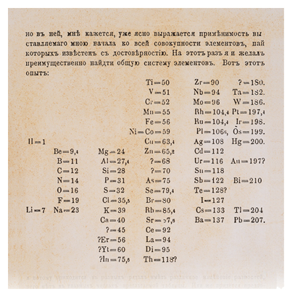
Mendeleev’s Periodic Table
Mendeleev’s Periodic Table
Notice the two question marks between zinc (Zn) and arsenic (As).
Mendeleev left these spaces in his table because he knew that bromine belonged with chlorine and iodine.
Ted Talks Mendeleev

Slide 7
Modern Periodic Table
Mendeleev realized some elements were out of place
Thought their masses were incorrect
Pre-dated discovery of subatomic particles
Moseley
Organized table by increasing atomic number
Took care of the discrepancies caused by using atomic mass

Slide 8
Modern Periodic Table
Based on the increase in number of protons (atomic number)
Arranged this way, there is a periodic repetition of physical and chemical properties = Periodic Law

Slide 9
Modern Periodic Table
Seven rows
Each is a period
Each corresponds to an energy level
Higher numbered periods are longer because there are more energy levels so there are more electrons
Elements’ characteristics change across a row
Starts with a metal
Goes through metalloids and non-metals (except period 1)
Ends with a noble gas

Slide 10
Modern Periodic Table
Periodic Law
Pattern of properties within a period repeats in the next period
Elements in the same column (group) will have similar physical and chemical properties
Example
Group 1 – Very reactive
Group 18 – Not reactive at all

Slide 11
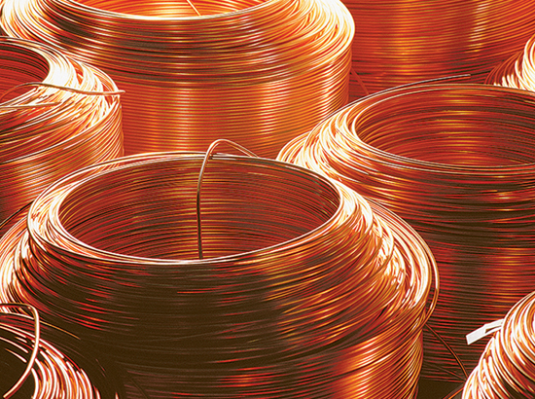
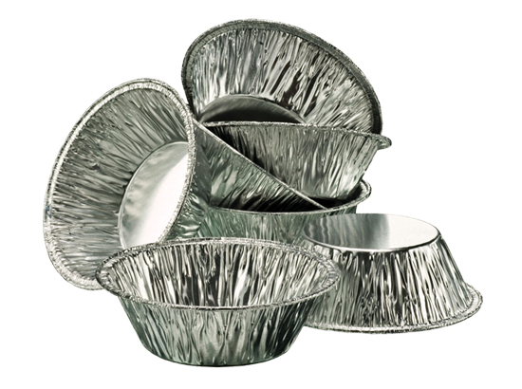
6.1 Classes of Elements
Metals
Majority of the elements
In s, p, d, and f blocks
In groups 1-15
Characteristics
Good conductors of electricity and heat
Shiny
Malleable
Ductile
Solid except Hg
Silver except Au and Cu

Slide 12
6.1 Classes of Elements
Non-metals
Small part of periodic table
Found in p block only (except H)
Characteristics
Non-conductors
Brittle
Solid, liquid, or gas
Many colors

Slide 13
6.1 Classes of Elements
Metalloids
B, Si, Ge, As, Sb, Te, At (?)
Characteristics of both metals and non-metals
metal-like properties:
shiny, solid, semi-conductors
Non-metal-like properties:
Non-conductors unless cooled or doped
brittle

