Slide 1
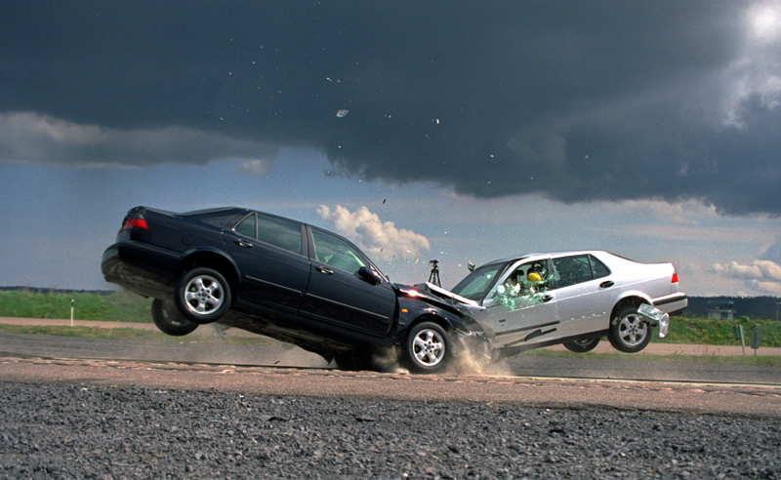
Section 2: Conservation of Momentum

Slide 2
Quick Q’s
Q: You are stuck in space and are given a carbon fiber nano tube rope that is connected to the earth so that you may pull your self back.
1) Will the earth budge, why or why not? Vsauce Jumping example
2) Who has the greatest change in momentum?

Slide 3
Law of conservation of Momentum
Total Initial Momentum = Total Final Momentum
Under what conditions will this not be true?

Slide 4
For Momentum to be Conserved
1) Must be a closed system: Where the mass of the system does not change.
2) All forces on the system must be internal: where there are no external forces from outside contact or field forces.
-this is considered to be an isolated system

Slide 5
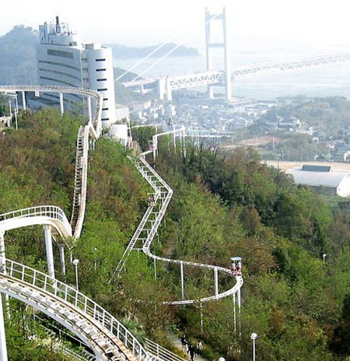
Is this roller coaster a closed system? Is it an isolated system?
Notes:
5

Slide 6
Closed systems
No truly closed, isolated systems
But lots of systems that are significantly closed and isolated to allow use of the idea of momentum conservation
Error has to be insignificant for system to be closed

Slide 7
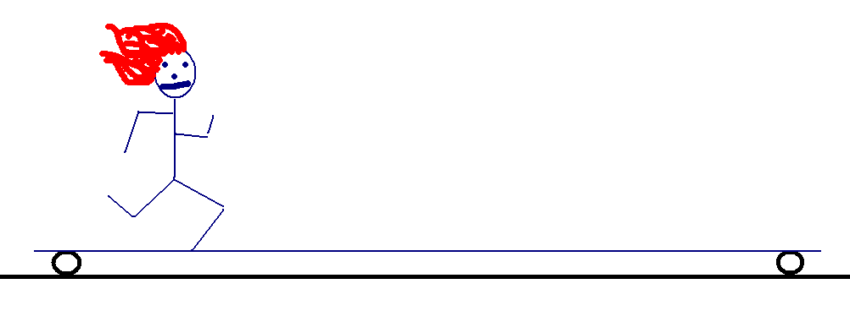
Student on cart
1) What will happen to the cart if the student starts moving forward?
2) What will happen to system (student and cart) if the students suddenly stops?

Slide 8
Stuck in Space
You are stuck in space so that you back is against the Earth. What can you do to turn around? Sit on a swivel chair and find out.

Slide 9
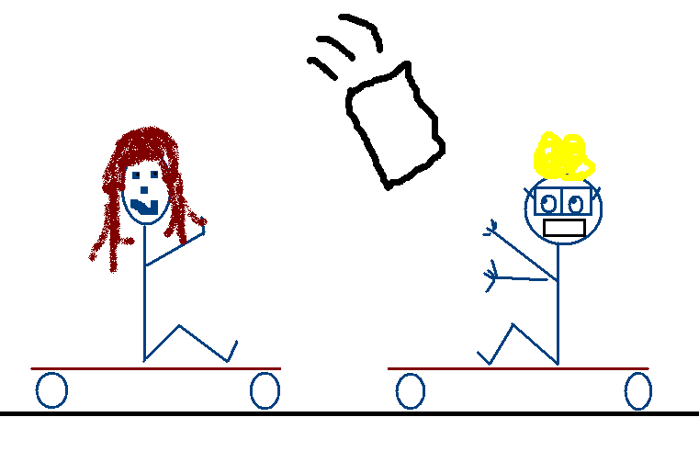
Pass the rice bag.
1) What will happen to the system as rice bag is passed back and forth.
Hint: Think of the total momentum of the system.

Slide 10
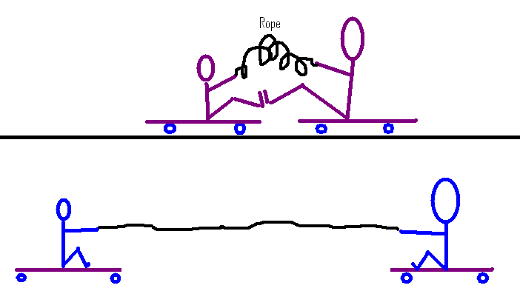
1) Who will travel the fastest?
2) When the line is completely stretched, which way will they budge?

Slide 11
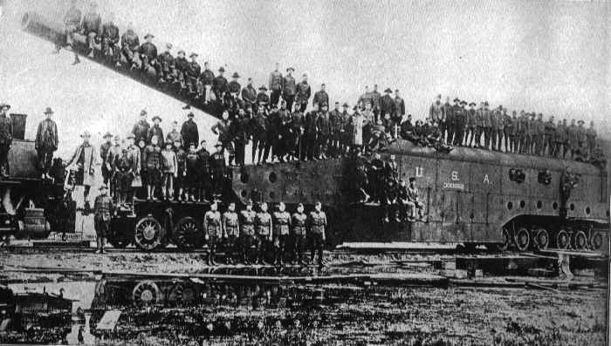
Using conservation of momentum to explain recoil
Notes:
11

Slide 12
Math behind recoil
Initial momentum of bullet and gun = 0
The sum of the momentums of both must total 0
Momentum of gun = -(Momentum of bullet)
Notes:
12

Slide 13
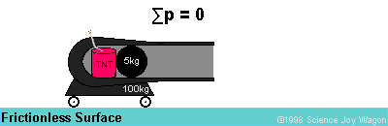
Sample problem 1:
A 50,000 kg cannon fires a 30 kg shell with a velocity of 400 m/s. If the cannon is on wheels, find its recoil velocity:

Slide 14
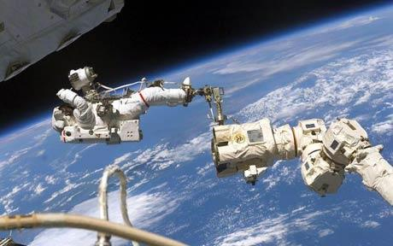
Sample Problem 2: Two astronauts are moving with a velocity of 25m/s and push off of each other so astronaut A has a velocity of zero. If astronaut A has a mass of 90kg and astronaut B has a mass of 100kg, find the velocity of B.

Slide 15
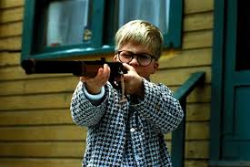
Example #3
Ralphie shoots a 87g BB from his 4.8 kg “Red Rider BB gun”. The BB leaves the gun at 600 m/s. With what speed did Ralphie’s gun smack him in the face?
Notes:
15

