Slide 1
III. Periodic Trends
Ch. 6.3 Periodic Trends

Slide 2
A. Periodic Law
When elements are arranged in order of increasing atomic #, elements with similar properties appear at regular intervals.

Slide 3
B. Chemical Reactivity
Families
Similar valence e⁻ within a group result in similar chemical properties

Slide 4
B. Chemical Reactivity
Alkali Metals
Alkaline Earth Metals
Transition Metals
Halogens
Noble Gases

Slide 5
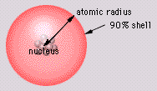
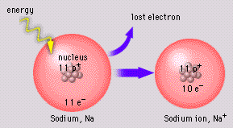
C. Other Properties
Atomic Radius
size of atom
First Ionization Energy
Energy required to remove one e⁻ from a neutral atom.
© 1998 LOGAL
Melting/Boiling Point
© 1998 LOGAL

Slide 6
D. Atomic Radius
Atomic Radius
K
Na
Li
Ar
Ne

Slide 7
D. Atomic Radius
Atomic Radius
Increases to the LEFT and DOWN

Slide 8
D. Atomic Radius
Why larger going down?
Higher energy levels have larger orbitals
Shielding - core e⁻ block the attraction between the nucleus and the valence e⁻
Why smaller to the right?
Increased nuclear charge without additional shielding pulls e⁻ in tighter

Slide 9
E. Ionization Energy
First Ionization Energy
He
Ne
Ar
Li
Na
K

Slide 10
E. Ionization Energy
First Ionization Energy
Increases UP and to the RIGHT

Slide 11
E. Ionization Energy
Why opposite of atomic radius?
In small atoms, e⁻ are close to the nucleus where the attraction is stronger
Why small jumps within each group?
Stable e⁻ configurations don’t want to lose e⁻

Slide 12
E. Ionization Energy
Successive Ionization Energies
Large jump in I.E. occurs when a CORE e⁻ is removed.
Mg 1st I.E. 736 kJ
2nd I.E. 1,445 kJ
Core e⁻ 3rd I.E. 7,730 kJ

Slide 13
E. Ionization Energy
Successive Ionization Energies
Large jump in I.E. occurs when a CORE e⁻ is removed.
Al 1st I.E. 577 kJ
2nd I.E. 1,815 kJ
3rd I.E. 2,740 kJ
Core e⁻ 4th I.E. 11,600 kJ

Slide 14
F. Melting/Boiling Point
Melting/Boiling Point
Highest in the middle of a period.

Slide 15
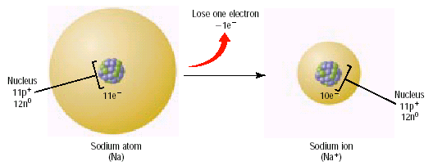
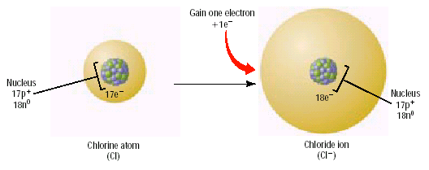
G. Ionic Radius
Ionic Radius
Cations (+)
lose e⁻
smaller
Anions (–)
gain e⁻
larger
© 2002 Prentice-Hall, Inc.

Slide 16
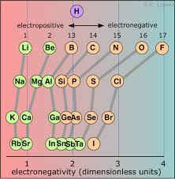
H. Electronegativity
Electronegativity
A measure of the ability of a specified atom to attract electrons in a molecule

Slide 17
H. Electronegativity
Electronegativity
Increases UP and to the RIGHT

Slide 19
Examples
Which atom has the larger radius?
Be or Ba
Ca or Br
Ba
Ca

Slide 20
Examples
Which atom has the higher 1st I.E.?
N or Bi
Ba or Ne
N
Ne

Slide 21
Examples
Which atom has the higher melting/boiling point?
Li or C
Cr or Kr
C
Cr

Slide 22
Examples
Which particle has the larger radius?
S or S²⁻
Al or Al³⁺
S²⁻
Al

