Slide 1
I. Introduction to Bonding
Ch. 6 & 7 - Chemical Bonding

Slide 2
A. Vocabulary
Chemical Bond
attractive force between atoms or ions that binds them together as a unit
bonds form in order to…
decrease potential energy (PE)
increase stability

Slide 3
A. Vocabulary
CHEMICAL FORMULA
IONIC
COVALENT
Formula
Unit
Molecular
Formula
NaCl
CO₂

Slide 4
A. Vocabulary
COMPOUND
more than 2
elements
2 elements
Binary
Compound
Ternary
Compound
NaCl
NaNO₃

Slide 5
A. Vocabulary
ION
1 atom
2 or more atoms
Monatomic
Ion
Polyatomic
Ion
Na⁺
NO₃⁻

Slide 6
B. Types of Bonds
IONIC
COVALENT
Bond Formation
e⁻ are transferred from metal to nonmetal
e⁻ are shared between two nonmetals
Type of Structure
crystal lattice
true molecules
Physical
State
liquid or gas
solid
Melting
Point
high
low
Solubility in
Water
yes
usually not
Electrical Conductivity
yes (solution or liquid)
no
Other
Properties
odorous

Slide 7
B. Types of Bonds
METALLIC
Bond Formation
e⁻ are delocalized among metal atoms
Type of Structure
“electron sea”
Physical
State
solid
Melting
Point
very high
Solubility in
Water
no
Electrical Conductivity
yes (any form)
Other
Properties
malleable, ductile, lustrous

Slide 8
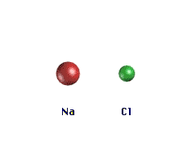
B. Types of Bonds
RETURN

Slide 9
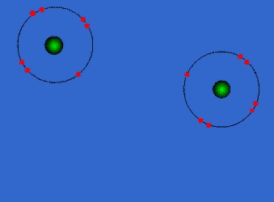
B. Types of Bonds
RETURN

Slide 10
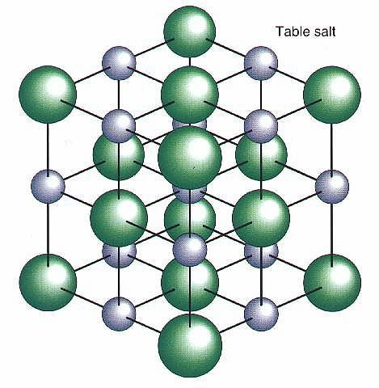
B. Types of Bonds
Ionic Bonding - Crystal Lattice
RETURN

Slide 11
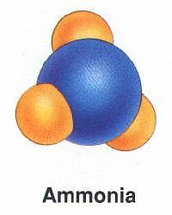
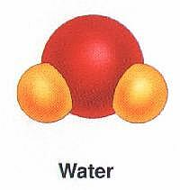
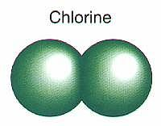
B. Types of Bonds
Covalent Bonding - True Molecules
Diatomic Molecule
RETURN

Slide 12
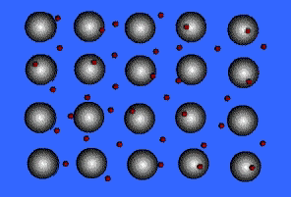
B. Types of Bonds
Metallic Bonding - “Electron Sea”
RETURN

Slide 13
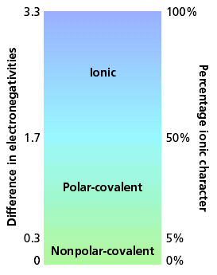
C. Bond Polarity

Slide 14
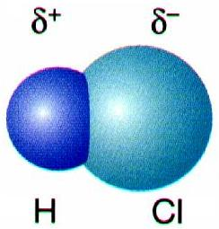
C. Bond Polarity
Electronegativity
Attraction an atom has for a shared pair of electrons.
higher e⁻neg atom ⇒ δ⁻
lower e⁻neg atom⇒ δ⁺

Slide 15
C. Bond Polarity
Electronegativity Trend (p. 151)
Increases up and to the right.

Slide 16
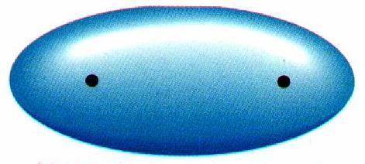
C. Bond Polarity
Nonpolar Covalent Bond
e⁻ are shared equally
symmetrical e⁻ density
usually identical atoms

Slide 17
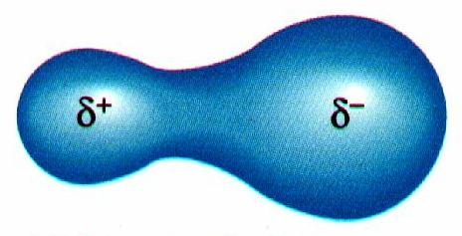
C. Bond Polarity
Polar Covalent Bond
e⁻ are shared unequally
asymmetrical e⁻ density
results in partial charges (dipole)
δ⁺
δ⁻

Slide 18
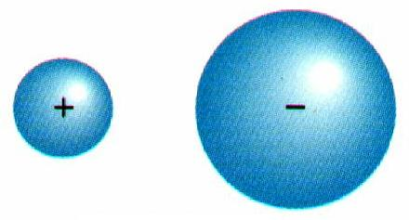
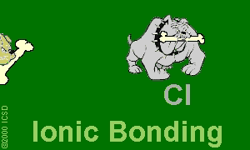
C. Bond Polarity
Nonpolar
Polar
Ionic
View Bonding Animations.

Slide 19
C. Bond Polarity
Examples:
Cl₂
HCl
NaCl
3.0-3.0=0.0
Nonpolar
3.0-2.1=0.9
Polar
3.0-0.9=2.1
Ionic

