Slide 1
Metallic Bonds
7.3

Slide 2
Cations packed in “a sea of electrons”

Slide 3
Metals
Metals consist of closely packed cations floating in a “sea of electrons”.
All of the atoms are able to share the electrons.
The electrons are not bound to individual atoms.

Slide 4
Properties of Metals
Good conductors
Ductile
Malleable
Electrons act as a lubricant, allowing cations to move past each other

Slide 5
Metals have a Crystalline Structure
Packed spheres of the same size and shape:
Body Centered Cubic
Face Centered Cubic
Hexagonal Close Packed

Slide 6
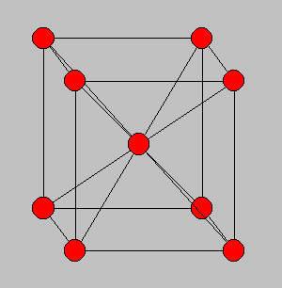
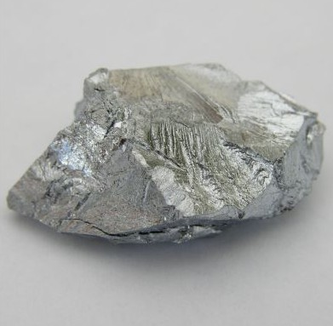
Body Centered Cubic
Chromium

Slide 7
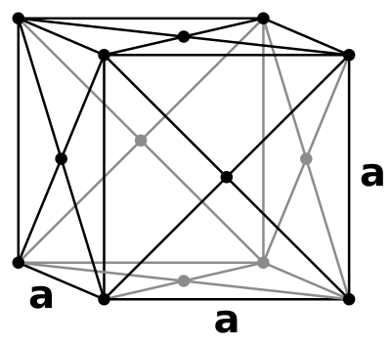
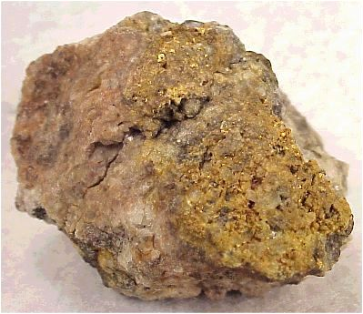
Face-Centered Cubic
Gold

Slide 8
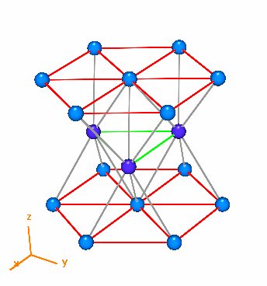
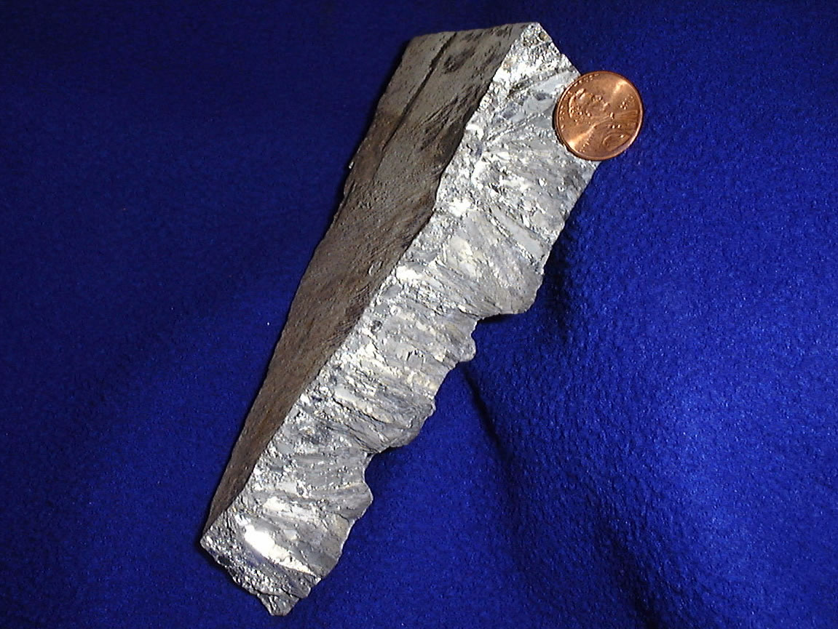
Hexagonal Close-Packed
http://phycomp.technion.ac.il/~pavelba/hcpS.gif
Zinc

Slide 9
Alloys
Mixtures of two or more elements, at least one of which is a metal.
Made by melting, mixing, then cooling the metals.
May contain non-metals like carbon.

Slide 10
Alloys
Properties are superior to their components.
Sterling silver
92.5% Ag, 7.5% Cu
Harder than silver
Bronze
7:1 Cu to Sn (tin)

Slide 11
Alloys
Stainless Steel
Fe 80.6%, Cr 18%, C 0.4%, Ni 1%
Cast Iron -Fe 96%, C 4%

Slide 12
Types of Alloys
Two types of formation:
Substitutional alloys
Similar size atoms – replacement
Interstitial alloys
Different size atoms – smaller ions fill interstices (spaces between atoms)

Slide 13
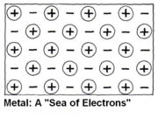
Why is a metal ductile but an ionic compound is not?

