Slide 1
Ch. 4 - Atomic Structure
II. Masses of Atoms
Mass Number
Isotopes
Relative Atomic Mass
Average Atomic Mass

Slide 2
Subatomic Particles
ATOM
NUCLEUS
ELECTRONS
PROTONS
NEUTRONS
NEGATIVE CHARGE
POSITIVE CHARGE
NEUTRAL CHARGE
QUARKS
equal in a neutral atom
Atomic Number
equals the # of...
Most of the atom’s mass.

Slide 3
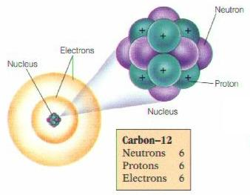
A. Mass Number
mass # = protons + neutrons
always a whole number
NOT on the Periodic Table!

Slide 4
B. Isotopes
Atoms of the same element with different mass numbers.
Nuclear symbol:
Mass #
Atomic #
Hyphen notation: carbon-12

Slide 5
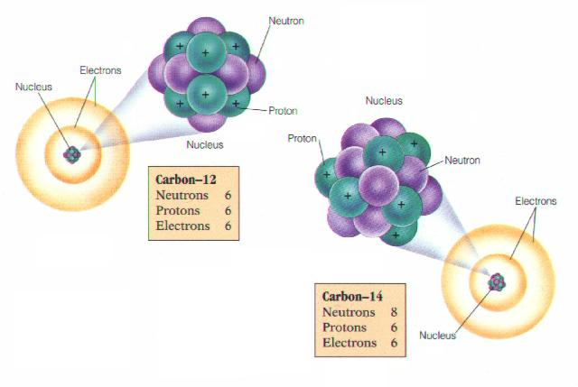
B. Isotopes

Slide 6
B. Isotopes
Chlorine-37
atomic #:
mass #:
# of protons:
# of electrons:
# of neutrons:
17
37
17
17
20

Slide 7
C. Relative Atomic Mass
¹²C atom = 1.992 × 10⁻²³ g
atomic mass unit (amu)
1 amu = ¹/₁₂ the mass of a ¹²C atom
1 p = 1.007276 amu 1 n = 1.008665 amu 1 e⁻ = 0.0005486 amu
© Addison-Wesley Publishing Company, Inc.

Slide 8
D. Average Atomic Mass
weighted average of all isotopes
on the Periodic Table
round to 2 decimal places
Avg.
Atomic
Mass

Slide 9
D. Average Atomic Mass
EX: Calculate the avg. atomic mass of oxygen if its abundance in nature is 99.76% ¹⁶O, 0.04% ¹⁷O, and 0.20% ¹⁸O.
Avg.
Atomic
Mass
16.00
amu

Slide 10
D. Average Atomic Mass
EX: Find chlorine’s average atomic mass if approximately 8 of every 10 atoms are chlorine-35 and 2 are chlorine-37.
Avg.
Atomic
Mass
35.40 amu

