Slide 1
Molecular Polarity
Ch. 8 Molecular Structure

Slide 2
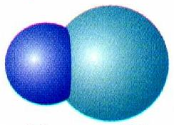
Dipole Moment
Direction of the polar bond in a molecule.
Arrow points toward the more e⁻neg atom.
δ⁺
δ⁻
H Cl

Slide 3
Determining Molecular Polarity
Depends on:
dipole moments
molecular shape

Slide 4
Determining Molecular Polarity
Nonpolar Molecules
Dipole moments are symmetrical and cancel out.
F
BF₃
B
F
F

Slide 5
Determining Molecular Polarity
Polar Molecules
Dipole moments are asymmetrical and don’t cancel .
O
net
dipole
moment
H₂O
H
H

Slide 6
Determining Molecular Polarity
Therefore, polar molecules have...
asymmetrical shape (lone pairs) or
asymmetrical atoms
H
net
dipole
moment
CHCl₃
Cl
Cl
Cl

