Slide 1
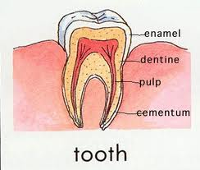
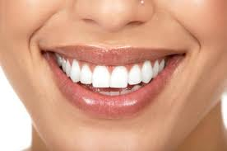
Fun Chemistry Idea of the day
Never brush your teeth after you eat. If you eat or drink something with an acid, such as juice, soda’s, fruits, dressings, or anything sugary, the acid breaks down the enamel on your teeth.
Instead wait 30 min – 10 hour for your saliva to neutralize the acid in your mouth so you are not brushing away your enamel.

Slide 2
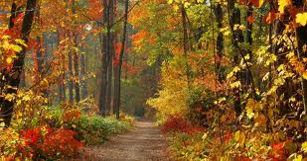
What do changing leaves have to do
with chemistry?

Slide 3
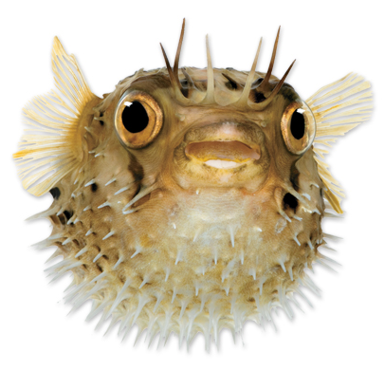
Why might this creature interest you if you were a chemist?
Fugu, also known as puffer fish, is a sushi delicacy that can also be lethal.
Recently this toxin has been put to good use, as scientists have discovered that a purified form of it can treat severe pain in cancer patients.

Slide 4

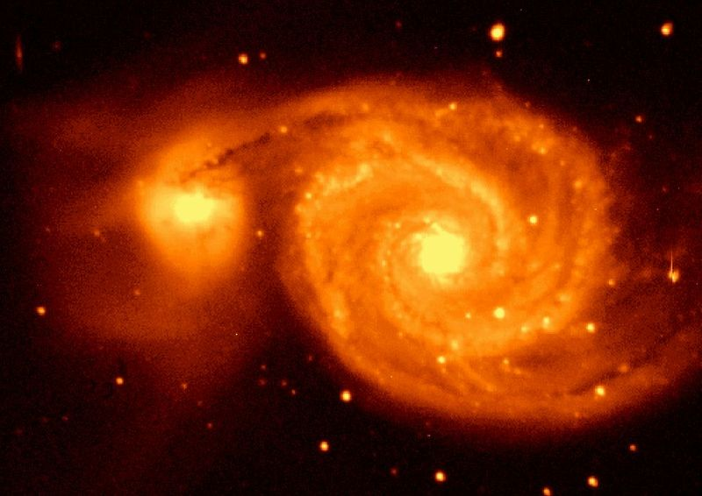
What Is Chemistry?
Matter is anything that has mass and occupies space.
The trees, the water, and the buildings are all examples of matter.

Slide 5
What Is Chemistry?
Chemistry answers many questions you may have about the world you live in.
Chemistry is the study of the composition of matter and the changes that matter undergoes.
Chemistry affects all aspects of life and most natural events because all living and nonliving things are made of matter.

Slide 6
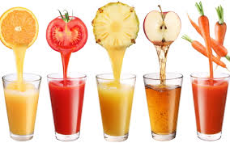
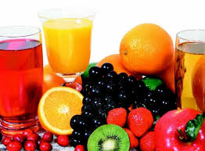
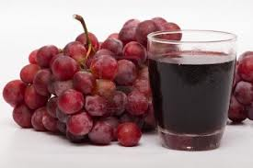
What is wrong with an advertisement for juice drinks that claims the juice is all-natural and free of chemicals?

Slide 7
What is wrong with an advertisement for juice drinks that claims the juice is all-natural and free of chemicals?
Everything is made up of matter; therefore, everything contains chemicals. Even all-natural products are made of chemicals.

Slide 8
Areas of Study
What are five traditional areas of study in chemistry?
organic chemistry
inorganic chemistry
biochemistry
analytical chemistry
physical chemistry

Slide 9
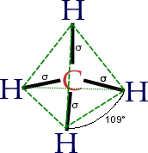
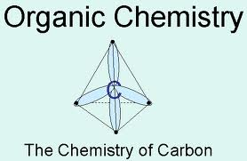
Most chemicals found in organisms contain carbon.
Organic chemistry is defined as the study of all chemicals containing carbon.

Slide 10
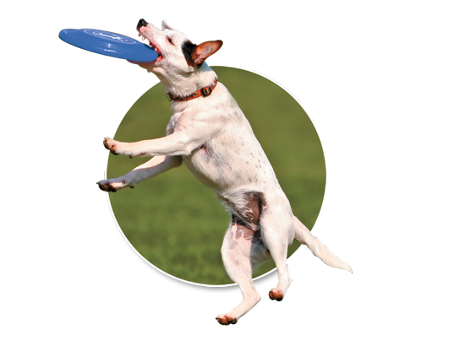
Areas of Study
An organic chemist might develop new lightweight plastics for flying disks.

Slide 11
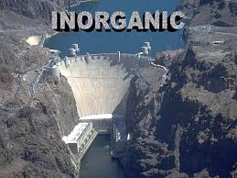
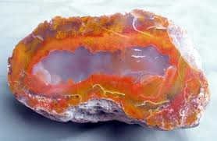
Areas of Study
The study of chemicals that, in general, do not contain carbon is called inorganic chemistry.
Many inorganic chemicals are found in nonliving things, such as rocks or building structures

Slide 12
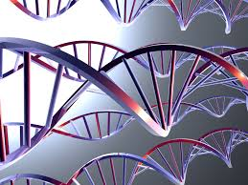
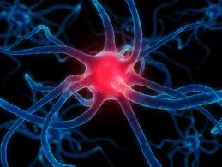
Areas of Study
The study of processes that take place in living organisms is biochemistry.
These processes include muscle contraction and digestion.

Slide 13
Areas of Study
A biochemist might study how the energy used for the contraction of muscles is produced and stored.

Slide 14
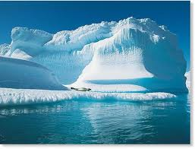
Areas of Study
The area of study that focuses on the composition of matter is analytical chemistry.
A task that would fall into this area of chemistry is measuring the level of carbon dioxide in the atmosphere.
  Climatologist

Slide 15
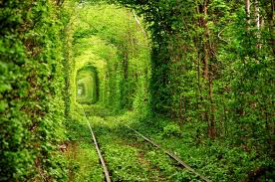
Areas of Study
Physical chemistry is the area that deals with the mechanism, rate, and energy transfer that occurs when matter undergoes a change.
A physical chemist might study factors that affect the rate of photosynthesis in trees.

Slide 16
Areas of Study
The boundaries between the five areas are not firm.
  A chemist is likely to be working in more than one area of chemistry at any given time.
  For example, an organic chemist uses analytical chemistry to determine the composition of an organic chemical.

Slide 17
Why would you study a puffer fish if you were a biochemist? If you were an organic chemist?

Slide 18
Why would you study a puffer fish if you were a biochemist? If you were an organic chemist?
Biochemists might study the puffer fish to determine how its toxin acts on the human body.
Organic chemists might study the composition of the puffer fish toxin.

Slide 19
Which area of study would you use to determine the components of an unknown liquid?
A. physical chemistry
B. biochemistry
C. organic chemistry
D. analytical chemistry

Slide 20
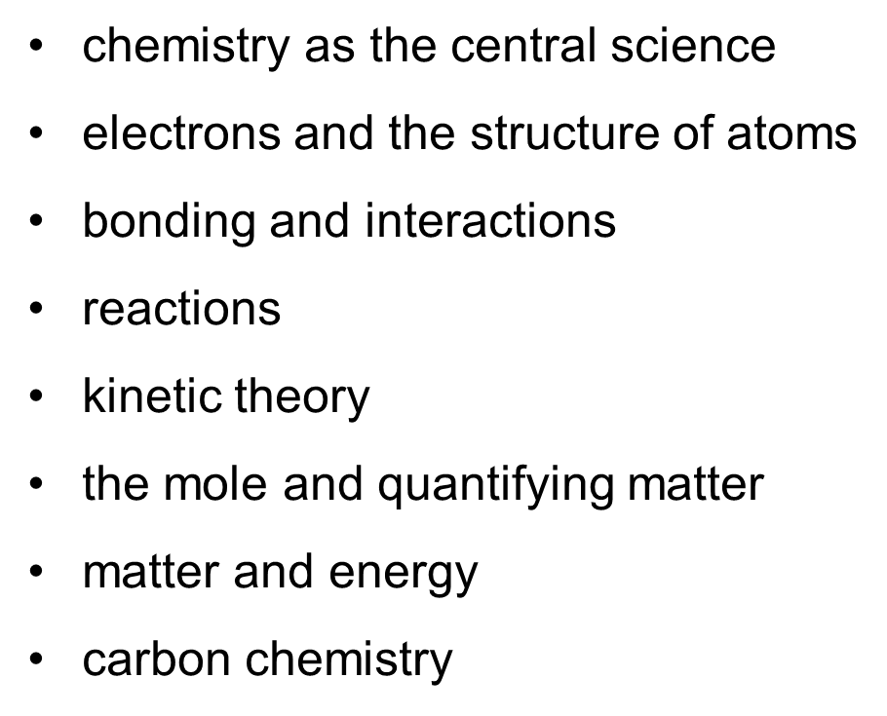
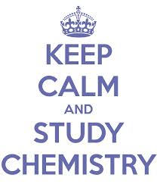
Big Ideas in Chemistry
What are the central themes of chemistry?

Slide 21
One evening as Max was out walking, Mrs. Zenitt called his name. He hurried across the street. She was standing in her front yard, but she guided him around to the back. "I was watching TV in the living room," she told him, "and I heard a crash. Just look!" She pointed to her back porch window. "Someone threw a rock through it. It's broken into a dozen pieces!“
"Do you know who did it?" he asked.
"No,” she replied, “He ran off, but I think maybe it was David Loring. We had a spat the other day because I told his parents he had to stop using my yard as a short cut. But I wouldn't accuse him of breaking a window without more proof.“
"I'll talk to him," Max said.
Source: http://kids.mysterynet.com/quicksolve/

Slide 22
He found David panting as he bounced a basketball under the light on his garage. "Did you just run from Mrs. Zenitt's?" Max asked. "Did you break her window?"
David shook his head. "No. I'm all out of breath because I've been out here shooting baskets. I don't know anything about a broken porch window."
"You're not telling the truth," Max said.
How did Max figure it out?

Slide 23
Solution
Max knew David was not telling the truth because he said "porch window." Max had not mentioned which of Mrs. Zenitt's windows had been broken. "This case was a real pane, but the solution was as clear as glass," Max told Nina later.

Slide 24
The Way Science Works
Key Ideas
  How Can I think like a scientist?
  How do scientists measure things?
Why it matters?
  Thinking logically, or like a scientist, can help you solve daily problems.
  Which method of training is helping me improve my running times?

Slide 25
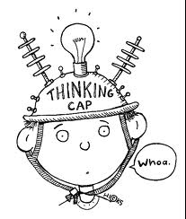
The Way Science Works
Activity
  Investigate the impact that adding various amounts of fertilizer has on plant growth. Think about what you would need to do to conduct this experiment.
Disclaimer****** - Thinking has been shown to challenge the capacity of your brain, I, Mr. Shull am not responsible for any resulting injuries of this activity, SO DON’T HURT YOURSELF!

Slide 26
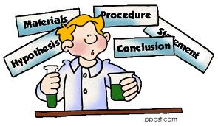
The Way Science Works
How can I think and act like scientist?
  Identifying problems, planning experiments, recording observations, and correctly reporting data are some of the most important science skills.
  Scientists approach a problem by thinking logically.

Slide 27
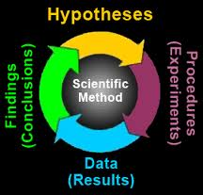
The Way Science Works
The Scientific Method
  a series of steps followed to solve problems including collecting data, formulating a hypothesis, testing the hypothesis, and stating conclusions
    The scientific method is a description to follow, not an exact path that has to be followed.
They are all intertwined!

Slide 28
The Way Science Works
Observations give additional data for a new hypothesis
Observe
Observe/watch anything in nature
Formulate a question
What do you want to know?
Research and collect data
What is already known about your question
Form a hypothesis
Propose an answer to your question based on observations, research, and data
Test the Hypothesis
Observe
Draw Conclusions
Did your results support your hypothesis? If not modify the hypothesis based on observations

Slide 29
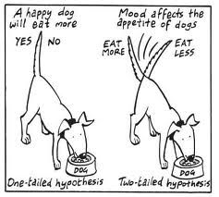
The Way Science Works
hypothesis: a possible explanation or answer that can be tested
  Scientists test a hypothesis by doing a controlled experiment.
  controlled experiment: an experiment in which the variables that could affect the experiment are kept constant (controlled) except for the one that you want to measure
  variable: a factor that changes in an experiment in order to test a hypothesis
    Only Change 1 Variable!!!!!!!!!!!!!!!!!!!!!!!!

Slide 30
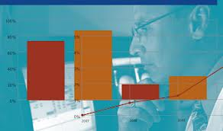
The Way Science Works
Experiments test ideas.
  No experiment is a failure!
  The results of every experiment can be used to revise the hypothesis or plan tests of a different variable
  Peer Reviewed Research: Research that has been reviewed by other scientists.
Other scientists perform the experiments themselves to confirm your results.

Slide 31
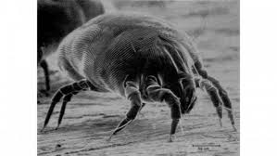
The Way Science Works
Science and technology are heavily dependent on one another.
What special tools can you think of that scientists use?
  Ex –
    Telescopes
    Particle Accelerators
    Satellites
    Many, many, many, many, many, many, many, many more.
    Microscope
      Types?
  New discoveries in technology can lead to new discoveries in science.
House dust mite

Slide 32
Case #1
Daily CSI
Can you solve it?
The Accident

Slide 33
Case Summary
There was nothing Leon, the driver, could do about the impending crash of the car he was driving. Leon knew the car would be completely demolished in the crash. After the crash Leon didn’t have a scratch on him. How can that be?

Slide 34
Solutions
Leon was driving a remote control car.
or
He was playing a video game.

Slide 35
The following data were obtained by adding several different amounts of weight to a spring and measuring the corresponding stretch.

Slide 36
Stretch (meters) | Weight (Newtons)
0.1240 | 6.0
0.1475 | 14.0
0.1775 | 22.0
0.1950 | 30.0
0.2195 | 38.0
0.2300 | 40.0
0.2525 | 47.0
0.2675 | 54.0
0.2875 | 58.0
The Newton is a unit of force or weight

Slide 37
There are two variables or parameters that can change during the experiment, weight and stretch.
As mentioned earlier the experimenter controls the amount of weight to be added.
The weight is therefore called the independent variable.
Again as mentioned before the amount that the spring stretches depends on how much weight is added. Hence the stretch is called the dependent variable.
The dependent variable is the quantity that depends on the independent variable.

Slide 38
A graph of this experimental data is shown on the next slide.
The independent variable is always plotted on the horizontal axis.
The dependent variable is plotted on the vertical axis.
Notice that each axis is not only labeled as to what is plotted on it, but also, the units in which the variable is displayed.
Units are important.

Slide 39
Stretch Versus Weight
0.30
Each graph should be identified with a title.
Weight, the independent variable, will be plotted along the horizontal axis.
0.26
Stretch, the dependent variable, will be plotted along the vertical axis.
0.22
The graph should be made so that the data fills as much of the page as possible. To do this, sometimes it is better not to start numbering an axis at zero, but rather a value near the first data point.
Stretch (meters)
0.18
0.14
0.10
0
10
20
30
40
50
60
Weight (Newtons)

Slide 40
Stretch Versus Weight - Susie Que
0.30
(58.0, 0.2875)
(54.0, 0.2675)
0.26
(47.0, 0.2525)
(40.0, 0.2300)
0.22
(38.0, 0.2195)
Let’s plot the data.
(30.0, 0.1950)
Stretch (meters)
0.18
(22.0, 0.1775)
This is not a connect-the-dot exercise.
Each data point should be circled, so that it can be easily found and distinguished from other dots on the paper.
(14.0, 0.1475)
0.14
(6.0, 0.1240)
The data appears to fit a straight line somewhat like this one.
0.10
0
10
20
30
40
50
60
Weight (Newtons)

Slide 41
Stretch Versus Weight - Susie Que
0.30
If there is a general trend to the data, then a best-fit curve describing this trend can be drawn.
In this example the data points approximately fall along a straight line.
This implies a linear relationship between the stretch and the weight.
0.26
0.22
Stretch (meters)
0.18
0.14
0.10
0
10
20
30
40
50
60
Weight (Newtons)

Slide 42
Scientific Laws and Theories
What are scientific theories, and how are they different from scientific laws?
Theories explain why something happens, laws explain how something works.
law: a descriptive statement or equation that reliably predicts events under certain conditions
theory: a system of ideas that explains many related observations and is supported by a large body of evidence acquired through scientific investigation

Slide 43
Observations
Any information collected with the senses.
    Quantitative – measureable or countable
        3 meters long
        4 marbles
        50 kilograms
        35 degrees Celsius
    Qualitative – describable, not measureable
        red flowers
        smells like fresh baked cookies
        Tastes bitter
The skill of describing scientific events

Slide 44
Inference
Conclusions or deductions based on observations.
The process of drawing a conclusion from given evidence.
Practice:
Observations:
  I hear people screaming
  I smell cotton candy, popcorn, and hamburgers
  I see a lot of people
Inference = ?

Slide 45
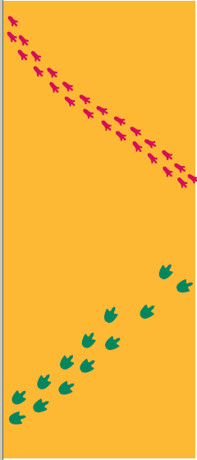
Look at these two sets of animal tracks.
List 3 OBSERVATIONS
Make an INFERENCE

Slide 46
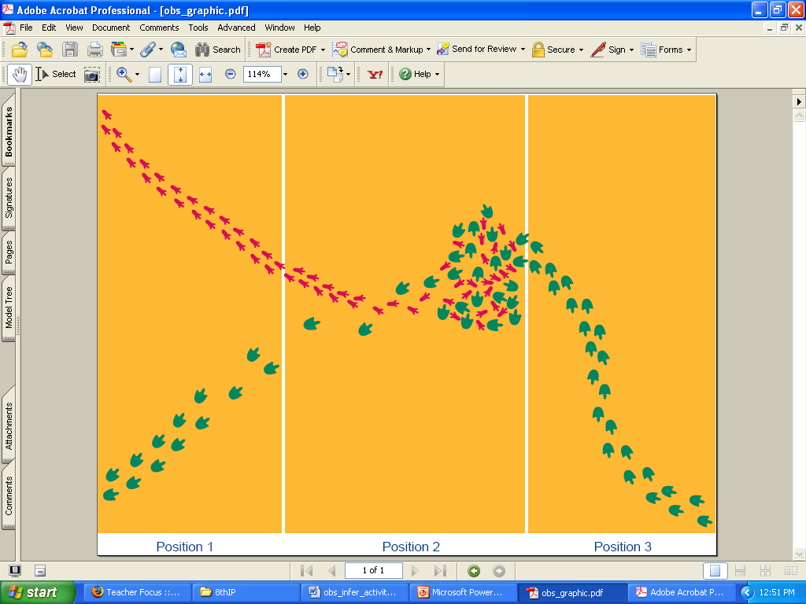
Now what do you think?
Make 3 OBSERVATIONS
Make an INFERENCE

Slide 47
Now what do you think?
Make 3 OBSERVATIONS
Make an INFERENCE

