Slide 1
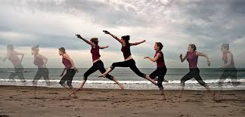
Motion in One Dimension

Slide 2
Motion in One Dimension
motion takes place over time and depends upon the frame of reference
frame of reference – a coordinate system for specifying the precise location of objects in space; only worry about those objects directly related to what you are observing or measuring

Slide 3
Motion in One Dimension
displacement – the change in position of an object; straight line distance from the beginning of the motion to the end of the motion; represents a change of position; vector quantity (has magnitude and direction)
Δx = x_{f} – x_{i}
Δx = displacement
x_{f} = final position
x_{i} = initial position

Slide 4
Motion in One Dimension
displacement is not always equal to the distance traveled
displacement can be positive or negative since it is a vector quantity; the + and – denote the direction of the displacement

Slide 5
Positive and Negative Displacements

Slide 6
Motion in One Dimension

Slide 7
Motion in One Dimension
velocity ≠ speed; speed is a scalar quantity only; velocity is speed in a certain direction (a vector quantity)
if you graph position vs time, the slope of your line gives you the velocity
instantaneous velocity – velocity at some specific instant or at a specific point in an object’s path

Slide 8
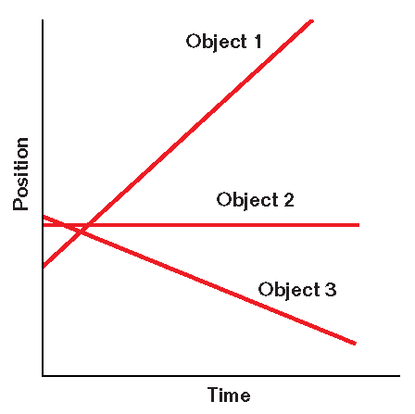
Interpreting Velocity Graphically
Chapter 2
For any position-time graph, we can determine the average velocity by drawing a straight line between any two points on the graph.
If the velocity is constant, the graph of position versus time is a straight line. The slope indicates the velocity.
Object 1: positive slope = positive velocity
Object 2: zero slope= zero velocity
Object 3: negative slope = negative velocity

Slide 9
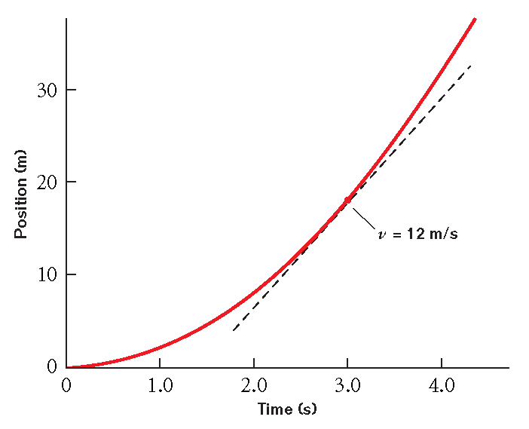
Interpreting Velocity Graphically
Chapter 2
The instantaneous velocity is the velocity of an object at some instant or at a specific point in the object’s path.
The instantaneous velocity at a given time can be determined by measuring the slope of the line that is tangent to that point on the position-versus-time graph.

Slide 10
Graphical Interpretation of Velocity

Slide 11
Motion in One Dimension

Slide 12
Motion in One Dimension
Velocity and Acceleration
v_{i} | a | Motion
+ | + | speeding up
- | - | speeding up
+ | - | slowing down
- | + | slowing down
- or + | 0 | constant velocity
0 | - or + | speeding up from rest
0 | 0 | remaining at rest

Slide 13
Constant Acceleration and Average Velocity

Slide 14
Motion in One Dimension

Slide 15
Practice
A plane starting from rest at one end of the runway undergoes a uniform acceleration of 4.8 m/s² for 15s before takeoff. What is the planes speed at takeoff?
How long must the runway be for the plane to be able to take off?

Slide 16
Motion in One Dimension

Slide 18
Air Resistance and Free Fall Acceleration
If an object falls through the air, it reaches a point where the air resistance slows the acceleration of the object
This does not mean that the object stops moving; the object stops accelerating; called terminal velocity
Example of free fall acceleration with air resistance

