Slide 1
Circular Motion

Slide 2
“Centrifugal Force”
“Centrifugal force” is a fictitious force - it is not an interaction between 2 objects, and therefore not a real force.
Nothing pulls an object away from the center of the circle.

Slide 3
“Centrifugal Force”
What is erroneously attributed to “centrifugal force” is actually the action of the object’s inertia - whatever velocity it has (speed + direction) it wants to keep.

Slide 4
Circular Motion Terms
The point or line that is the center of the circle is the axis of rotation.
If the axis of rotation is inside the object, the object is rotating (spinning).
If the axis of rotation is outside the object, the object is revolving.

Slide 5
Linear/Tangential Velocity
Objects moving in a circle still have a linear velocity = distance/time.
This is often called tangential velocity, since the direction of the linear velocity is tangent to the circle.
v

Slide 6
Rotational/Angular Velocity
Objects moving in a circle also have a rotational or angular velocity, which is the rate angular position changes.
Rotational velocity is measured in degrees/second, rotations/minute (rpm), etc.
Common symbol, ω (Greek letter omega)

Slide 7
Rotational & Linear Velocity
Linear velocity of a point depends on:
The rotational velocity of the point.
More rotational velocity means more linear velocity.
The distance from the point to the axis of rotation.
More distance from the axis means more linear velocity.

Slide 8
Acceleration
As an object moves around a circle, its direction of motion is constantly changing.
Therefore its velocity is changing.
Therefore an object moving in a circle is constantly accelerating.

Slide 9
Centripetal Acceleration
The acceleration of an object moving in a circle points toward the center of the circle.
This is called a centripetal (center pointing) acceleration.
a

Slide 10
Tangential velocity is the velocity traveling in a circle, so what is the distance of a circle?
So from V = d/t
D of a circle = 2πr
So v =
T = time of 1 revolution
2πr
____
T

Slide 11
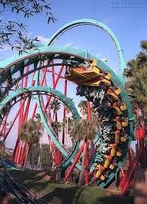
Centripetal Acceleration
The centripetal acceleration depends on:
The speed of the object.
The radius of the circle.
A_{cent} =
4π²r
a =
______
v²
T²
r
T = period of revolution

Slide 12
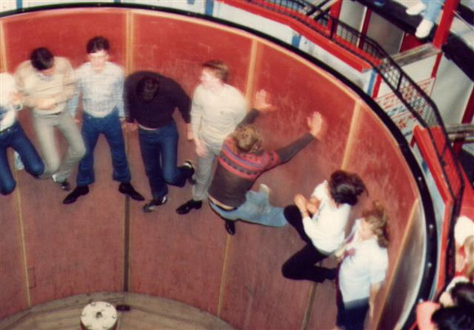
Practice
Pepe Roni is on the rotor. If he is 5.2 m from the center of the ride and has a centripetal acceleration of 4.05 m/s². What is his tangential speed?

Slide 13
Practice
A Blu Ray disk has a diameter of 12.0 cm and a rotation period of 0.100 s. Determine the centripetal acceleration at the outer edge of the disk.

Slide 14
Centripetal Force
Newton’s Second Law says that if an object is accelerating, there must be a net force on it.
For an object moving in a circle, this is called the centripetal force.
The centripetal force points toward the center of the circle.

Slide 15
Centripetal Force
In order to make an object revolve about an axis, the net force on the object must pull it toward the center of the circle.
This force is called a centripetal (center seeking) force.
F_{net}

Slide 16
Centripetal Force
Centripetal force on an object depends on:
The object’s mass - more mass means more force.
The object’s speed - more speed means more force.
And…

Slide 17
Centripetal Force
The centripetal force on an object also depends on:
The object’s distance from the axis (radius).
If linear velocity is held constant, more distance requires less force.
If rotational velocity is held constant, more distance requires more force.

Slide 18
Centripetal Force
In symbols:
mv²
F_{cent}=
r
Using f = ma , where a = centripetal acceleration
4π²mr
F_{cent}
=
_______
T²

Slide 19
Example
Determine the magnitude of the centripetal force exerted by the rim of a dragster’s wheel on a 45.0 kg tire. The tire has a 0.480 m radius and is rotating at a speed of 30.0 m/s

Slide 20
Example
Determine the maximum speed with which a 1500 kg car can safely travel around a circular track of 80.0 m if the coefficient of static friction b/w the tire and road is 0.30

