Slide 1
III. Colligative Properties
Ch. 13 & 14 - Solutions

Slide 2
A. Molality
mass of solvent only
1 kg water = 1 L water

Slide 3
A. Molality
Find the molality of a solution containing 75 g of MgCl₂ in 250 mL of water.
75 g MgCl₂
1 mol MgCl₂
95.21 g MgCl₂
0.25 kg water
= 3.2m MgCl₂

Slide 4
A. Molality
How many grams of NaCl are req’d to make a 1.54m solution using 0.500 kg of water?
0.500 kg water
1.54 mol NaCl
1 kg water
58.44 g NaCl
1 mol NaCl
= 45.0 g NaCl

Slide 5
A. Definition
Colligative Property
property that depends on the concentration of solute particles, not their identity

Slide 6
B. Types
Freezing Point Depression (Δt_{f})
f.p. of a solution is lower than f.p. of the pure solvent
Boiling Point Elevation (Δt_{b})
b.p. of a solution is higher than b.p. of the pure solvent

Slide 7
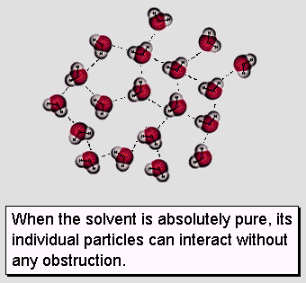
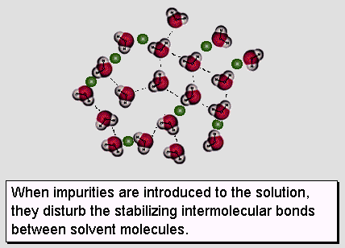
B. Types
Freezing Point Depression

Slide 8
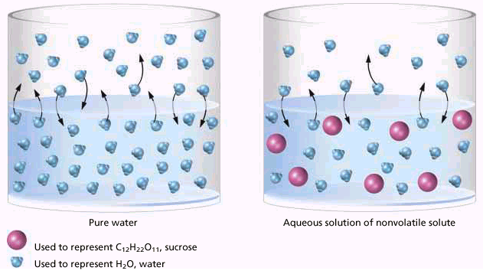
B. Types
Boiling Point Elevation
Solute particles weaken IMF in the solvent.

Slide 9
B. Types
Applications
salting icy roads
making ice cream
antifreeze
cars (-64°C to 136°C)
fish & insects

Slide 10
C. Calculations
Δt = k · m · n
Δt: change in temperature (°C)
k: constant based on the solvent (°C·kg/mol)
m: molality (m)
n: # of particles

Slide 11
C. Calculations
# of Particles
Nonelectrolytes (covalent)
remain intact when dissolved
1 particle
Electrolytes (ionic)
dissociate into ions when dissolved
2 or more particles

Slide 12
C. Calculations
At what temperature will a solution that is composed of 0.73 moles of glucose in 225 g of phenol boil?
GIVEN:
b.p. = ?
Δt_{b} = ?
k_{b} = 3.60°C·kg/mol
WORK:
m = 0.73mol ÷ 0.225kg
Δt_{b} = (3.60°C·kg/mol)(3.2m)(1)
Δt_{b} = 12°C
b.p. = 181.8°C + 12°C
b.p. = 194°C
m = 3.2m
n = 1
Δt_{b} = k_{b} · m · n

Slide 13
C. Calculations
Find the freezing point of a saturated solution of NaCl containing 28 g NaCl in 100. mL water.
GIVEN:
f.p. = ?
Δt_{f} = ?
k_{f} = 1.86°C·kg/mol
WORK:
m = 0.48mol ÷ 0.100kg
Δt_{f} = (1.86°C·kg/mol)(4.8m)(2)
Δt_{f} = 18°C
f.p. = 0.00°C - 18°C
f.p. = -18°C
m = 4.8m
n = 2
Δt_{f} = k_{f} · m · n

