Slide 1
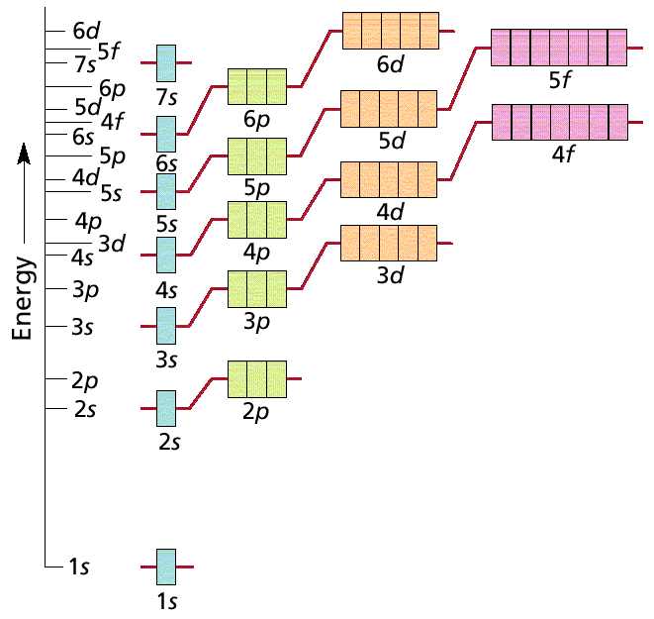
IV. Electron Configuration
Ch. 4 - Electrons in Atoms

Slide 2
Energy Levels
The Bohr Model
The rungs on this ladder are somewhat like the energy levels in Bohr’s model of the atom.
A person on a ladder cannot stand between the rungs. Similarly, the electrons in an atom cannot exist between energy levels.
The energy levels in atoms are unequally spaced, like the rungs in this unusual ladder. The higher energy levels are closer together.

Slide 3
Electron Arrangement in Atoms
Atomic Orbitals
Region where there is high probability of finding an electron
Energy levels
Represented by quantum numbers
Principal quantum number (n) = size of orbital
Also the same as the period of the element.
To what energy level does Sulfur (S) belong?
To find out how many electrons can be held in an energy level we use the equation 2n²

Slide 4
Sublevels
Sublevels
Orbitals with different shapes and energy levels within a main energy level
Represented by the letters
s= sphere (1 orbital)
p= dumbbell shape (3orbitals)
d= double dumbbell shape (5 orbitals)
f = hard to describe (7 orbitals)

Slide 5
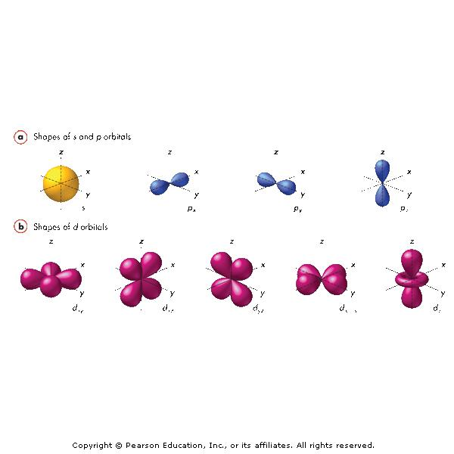

Slide 6
Energy Level | Sub-levels | Total Orbitals | Total Electrons | Total Electrons per Level
n = 1 | s | 1 (1s orbital) | 2 | 2
n = 2 | s p | 1 (2s orbital) 3 (2p orbitals) | 2 6 | 8
n = 3 | s p d | 1 (3s orbital) 3 (3p orbitals) 5 (3d orbitals) | 2 6 10 | 18
n = 4 | s p d f | 1 (4s orbital) 3 (4p orbitals) 5 (4d orbitals) 7 (4f orbitals) | 2 6 10 14 | 32

Slide 7
Electron Arrangement in Atoms
s sublevel
1 orbital
Can hold maximum of 2 electrons
p sublevel
3 orbitals
Can hold maximum of 6 electrons
d sublevel
5 orbitals
Can hold maximum of 10 electrons
f sublevel
7 orbitals
Can hold maximum of 14 electrons

Slide 8
A. General Rules
Pauli Exclusion Principle
Each orbital can hold TWO electrons with opposite spins.

Slide 9
A. General Rules
Aufbau Principle
Electrons fill the lowest energy orbitals first.
“Lazy Tenant Rule”

Slide 10
A. General Rules
Hund’s Rule
Within a sublevel, place one e⁻ per orbital before pairing them.
“Empty Bus Seat Rule”
WRONG
RIGHT

Slide 11
B. Notation
Orbital Diagram
O
8e⁻
1s
2s
2p
Electron Configuration
1s² 2s² 2p⁴

Slide 12
B. Notation
Longhand Configuration
S 16e⁻
1s²
2s²
2p⁶
3s²
3p⁴
Core Electrons
Valence Electrons
Shorthand Configuration
S 16e⁻ [Ne] 3s² 3p⁴

Slide 13
C. Periodic Patterns
s
p
1
2
3
4
5
6
7
d (n-1)
f (n-2)
6
7

Slide 14
C. Periodic Patterns
Period #
energy level (subtract for d & f)
A/B Group #
total # of valence e⁻
Column within sublevel block
# of e⁻ in sublevel

Slide 15
C. Periodic Patterns
Example - Hydrogen
1s¹
1st column of s-block
1st Period
s-block

Slide 16
C. Periodic Patterns
Shorthand Configuration
Core e⁻: Go up one row and over to the Noble Gas.
Valence e⁻: On the next row, fill in the # of e⁻ in each sublevel.
p
s
d (n-1)
f (n-2)

Slide 17
C. Periodic Patterns
Example - Germanium
[Ar]
4s²
3d¹⁰
4p²

Slide 18
D. Stability
Full energy level
Full sublevel (s, p, d, f)
Half-full sublevel

Slide 19
D. Stability
Electron Configuration Exceptions
Copper
EXPECT: [Ar] 4s² 3d⁹
ACTUALLY: [Ar] 4s¹ 3d¹⁰
Copper gains stability with a full d-sublevel.

Slide 20
D. Stability
Electron Configuration Exceptions
Chromium
EXPECT: [Ar] 4s² 3d⁴
ACTUALLY: [Ar] 4s¹ 3d⁵
Chromium gains stability with a half-full d-sublevel.

Slide 21
D. Stability
Ion Formation
Atoms gain or lose electrons to become more stable.
Isoelectronic with the Noble Gases.
1+
2+
3+
NA
3-
2-
1-
0

Slide 22
D. Stability
Ion Electron Configuration
Write the e⁻ config for the closest Noble Gas
EX: Oxygen ion → O²⁻ ≡ Ne
O²⁻ 10e⁻ [He] 2s² 2p⁶

