Slide 1
I. The Nature of Solutions
Ch. 13 & 14 - Solutions

Slide 2
A. Definitions
Solution - homogeneous mixture
Solute - substance being dissolved

Slide 3
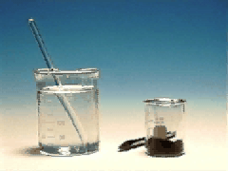
A. Definitions
Solute - KMnO₄
Solvent - H₂O

Slide 4
B. Solvation
Solvation – the process of dissolving
First...
solute particles are surrounded by solvent particles
solute particles are separated and pulled into solution
Then...

Slide 5
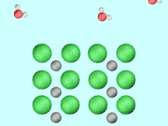
B. Solvation
Dissociation
separation of an ionic solid into aqueous ions
NaCl(s) → Na⁺(aq) + Cl–(aq)

Slide 6
B. Solvation
-
+
-
+
-
+
sugar
acetic acid
salt
Non-
Electrolyte
Weak
Electrolyte
Strong
Electrolyte
solute exists as
molecules only
solute exists as
ions and
molecules
solute exists as
ions only
DISSOCIATION
IONIZATION

Slide 7
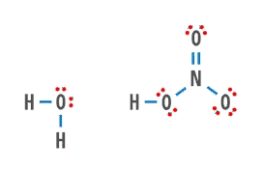
B. Solvation
Ionization
breaking apart of some polar molecules into aqueous ions
HNO₃(aq) + H₂O(l) → H₃O⁺(aq) + NO₃–(aq)

Slide 8
B. Solvation
Molecular Solvation
molecules stay intact
C₆H₁₂O₆(s) → C₆H₁₂O₆(aq)

Slide 9
B. Solvation
“Like Dissolves Like”
NONPOLAR
NONPOLAR
POLAR
POLAR

Slide 10
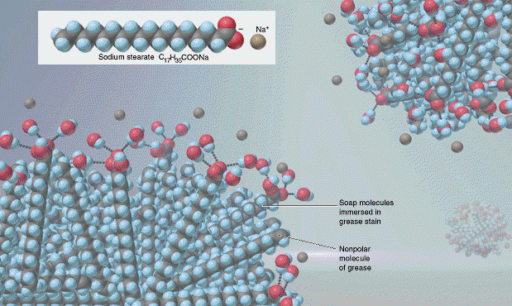
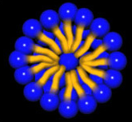
B. Solvation
Soap/Detergent
polar “head” with long nonpolar “tail”
dissolves nonpolar grease in polar water

Slide 11
C. Solubility
UNSATURATED SOLUTION
more solute dissolves
SATURATED SOLUTION
no more solute dissolves
SUPERSATURATED SOLUTION
becomes unstable, crystals form
concentration

Slide 12
C. Solubility
Solubility
maximum grams of solute that will dissolve in 100 g of solvent at a given temperature
varies with temp
based on a saturated soln

Slide 13
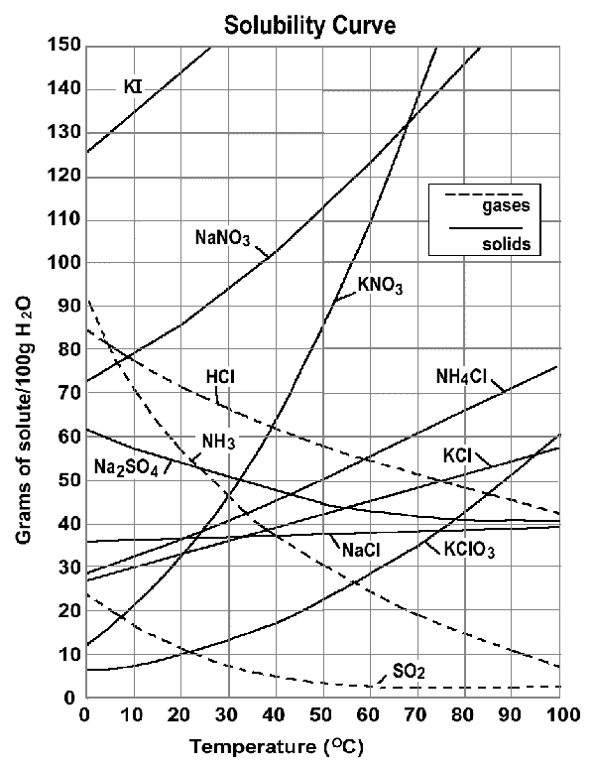
C. Solubility
Solubility Curve
shows the dependence of solubility on temperature

Slide 14
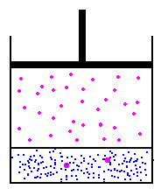
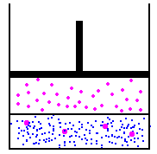
C. Solubility
Solids are more soluble at...
high temperatures.
Gases are more soluble at...
low temperatures &
high pressures (Henry’s Law).
EX: nitrogen narcosis, the “bends,” soda

