Slide 1
Monatomic Ions
A few transition metals have only one ionic charge.
The names of these cations do not have a Roman numeral.
These exceptions include silver, with cations that have a 1+ charge (Ag⁺), as well as cadmium and zinc, with cations that have a 2+ charge (Cd²⁺ and Zn²⁺).

Slide 2
C. Ionic Nomenclature
Consider the following:
Does it contain a polyatomic ion?
-ide, 2 elements ⇒ no
-ate, -ite, 3+ elements ⇒ yes
Does it contain a Roman numeral?
Check the table for metals not in Groups 1 or 2.
No prefixes!

Slide 3
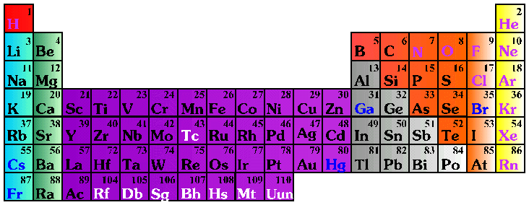
C. Ionic Nomenclature
Common Ion Charges
1+
0
2+
3+
NA
3-
2-
1-

Slide 4
C. Ionic Nomenclature
Ionic Names
Write the names of both ions, cation first.
Change ending of monatomic ions to -ide.
Polyatomic ions have special names.
Stock System - Use Roman numerals to show the ion’s charge if more than one is possible. Overall charge must equal zero.

Slide 5
C. Ionic Nomenclature
potassium chloride
magnesium nitrate
copper(II) chloride
K⁺ Cl⁻
⇒ KCl
Mg²⁺ NO₃⁻
⇒ Mg(NO₃)₂
Cu²⁺ Cl⁻
⇒ CuCl₂

Slide 6
Ionic Nomenclature
Ionic Formulas
Write each ion, cation first. Don’t show charges in the final formula.
Overall charge must equal zero.
If charges cancel, just write symbols.
If not, use subscripts to balance charges.
Use parentheses to show more than one polyatomic ion.
Stock System - Roman numerals indicate the ion’s charge.

Slide 7
C. Ionic Nomenclature
NaBr
Na₂CO₃
FeCl₃
sodium bromide
sodium carbonate
iron(III) chloride

