Slide 1
Le Chatelier’s Principle and Equilibrium

Slide 2
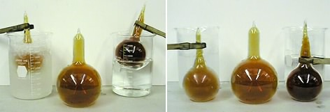
Reversible Reactions
Occur simultaneously in both directions.
Heat +N₂O₄ (g) 2NO₂ (g)
Colder temp
Warmer temp

Slide 3
Example of a Reversible Reaction
Heat +N₂O₄ (g) 2NO₂ (g)
Colder temp
Warmer temp

Slide 4
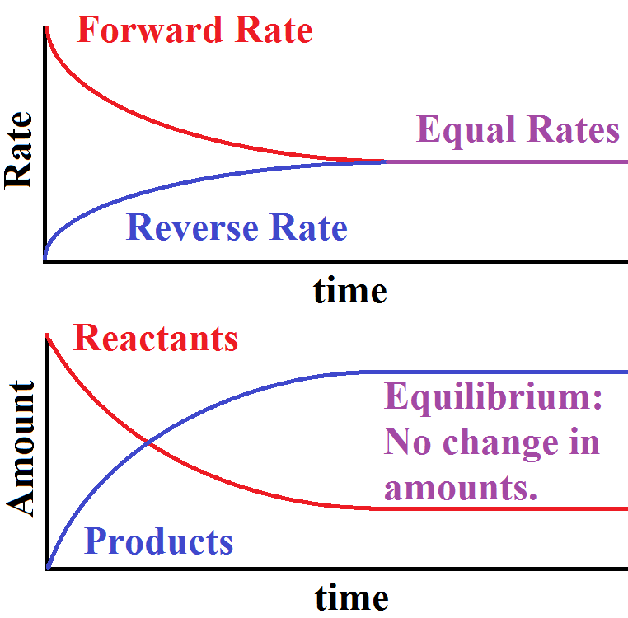
Equilibrium
A state of balance at which the rates of the forward and reverse reactions are equal.

Slide 5
Equilibrium Position
The relative concentrations of reactants and products at equilibrium.
At this point the concentrations don’t change unless a stress is applied to change the equilibrium.

Slide 6
Le Châtelier’s Principle
If a stress is applied to a system in dynamic equilibrium, the system changes to relieve the stress.
System stresses:
Concentration of reactants or products
Temperature

Slide 7
Effect of Concentration of Reactants
Adding reactant shifts the reaction toward the products. Why?
Stress: Increasing reactants
Relief: Decreasing reactants
Shift: to the right (products)
H₂O (l) + CO₂ (g) H₂CO₃ (aq)

Slide 8
Effect of Concentration of Products
Adding products shifts the reaction toward the reactants. Why?
Stress: Increasing products
Relief: Decreasing products
Shift: to the left (reactants)
H₂O (l) + CO₂ (g) H₂CO₃ (aq)

Slide 9
Effect of Temperature
Increasing the temperature causes the equilibrium to shift in the direction that absorbs heat. Stress: Increase in Temp
Relief: Decrease in Temp
Shift: Towards the left
SO₂ (g) + O₂ (g) 2SO₃ (g) + heat

Slide 10
Effect of Pressure
Affects gases only.
For unequal number of moles of reactants and products, if pressure is increased, the equilibrium will shift to reduce the number of particles.
For equal number of moles of reactants and products, no shift occurs.
2NO₂ (g) N₂O₄ (g)

Slide 11
Ex: Effect of Pressure
2NO₂ (g) N₂O₄ (g)
Stress: increasing the pressure
Relief: decreasing the pressure
Shift: to the right (side of less molecules)

Slide 12
Change amount of Catalyst?
NO! This does not affect the position of the equilibrium. It speeds the reaction in BOTH directions, so that it reaches equilibrium faster.

