Slide 1
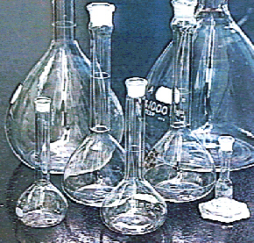
Molarity
Ch. 10– The Mole

Slide 2
Molarity
Concentration of a solution.
substance being dissolved
total combined volume

Slide 3
Molarity
2M HCl
What does this mean?

Slide 4
Molarity Calculations
6.02 × 10²³
(particles/mol)
molar mass
(g/mol)
MASS
IN
GRAMS
MOLES
NUMBER
OF
PARTICLES
Molarity
(mol/L)
LITERS
OF
SOLUTION

Slide 5
Molarity Calculations
How many grams of NaCl are required to make 0.500L of 0.25M NaCl?
0.500 L
0.25 mol
1 L
58.44 g
1 mol
= 7.3 g NaCl

Slide 6
Molarity Calculations
Find the molarity of a 250 mL solution containing 10.0 g of NaF.
10.0 g
1 mol
41.99 g
= 0.238 mol NaF
0.238 mol
0.25 L
M =
= 0.95M NaF

