Slide 1
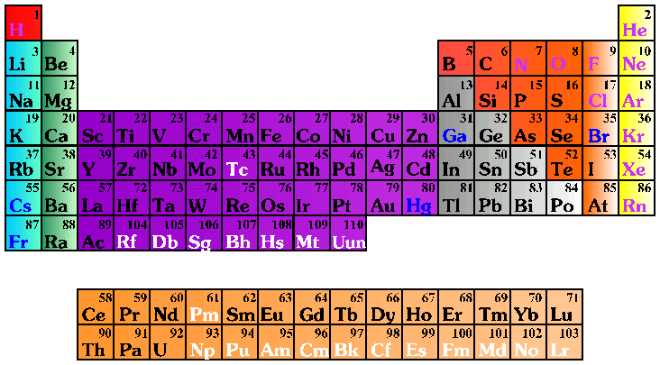
Molecular Nomenclature
Prefix System (binary compounds)
1. Less e⁻neg atom comes first.
2. Add prefixes to indicate # of atoms. Omit mono- prefix on first element.
3. Change the ending of the second element to -ide.

Slide 2
Molecular Nomenclature
PREFIX
mono-
di-
tri-
tetra-
penta-
hexa-
hepta-
octa-
nona-
deca-
NUMBER
1
2
3
4
5
6
7
8
9
10

Slide 3
Molecular Nomenclature
CCl₄
N₂O
SF₆
carbon tetrachloride
dinitrogen monoxide
sulfur hexafluoride

Slide 4
Molecular Nomenclature
arsenic trichloride
dinitrogen pentoxide
tetraphosphorus decoxide
AsCl₃
N₂O₅
P₄O₁₀

Slide 5
Molecular Nomenclature
The Seven Diatomic Elements
Br₂ I₂ N₂ Cl₂ H₂ O₂ F₂
H
N
O
F
Cl
Br
I

