Slide 1
Objectives
Explain how Newton’s law of universal gravitation accounts for various phenomena, including satellite and planetary orbits, falling objects, and the tides.
Apply Newton’s law of universal gravitation to solve problems.

Slide 2
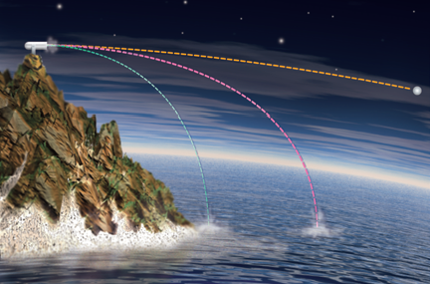
Gravitational Force
Chapter 7
Orbiting objects are in free fall.
To see how this idea is true, we can use a thought experiment that Newton developed. Consider a cannon sitting on a high mountaintop.
Each successive cannonball has a greater initial speed, so the horizontal distance that the ball travels increases. If the initial speed is great enough, the curvature of Earth will cause the cannonball to continue falling without ever landing.

Slide 3
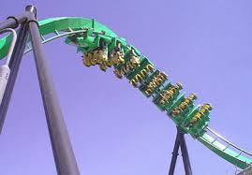
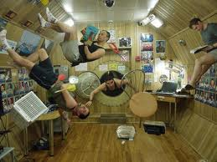
Free fall
When astronauts are in in space, or you get that “weightlessness feeling on a rollercoaster. You are experiencing free fall.
Both you and the object are falling at the same rate.

Slide 4
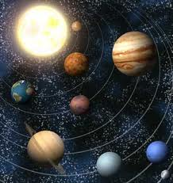
Gravitational Force, continued
Chapter 7
The centripetal force that holds the planets in orbit is the same force that pulls an apple toward the ground—gravitational force.
Gravitational force is the mutual force of attraction between particles of matter.
Gravitational force depends on the masses and on the distance between them.

Slide 5
Gravitational Force
Chapter 7
Newton developed the following equation to describe quantitatively the magnitude of the gravitational force if distance r separates masses m₁ and m₂:
The constant G, called the constant of universal gravitation, equals 6.673 × 10^{–11} N•m²/kg².
Discovered by the Cavendish Experiment

Slide 6
Gravitational Force
Chapter 7
The gravitational forces that two masses exert on each other are always equal in magnitude and opposite in direction.
This is an example of Newton’s third law of motion.
One example is the Earth-moon system
As a result of these forces, the moon and Earth each orbit the center of mass of the Earth-moon system. Because Earth has a much greater mass than the moon, this center of mass lies within (or near) Earth.

Slide 7
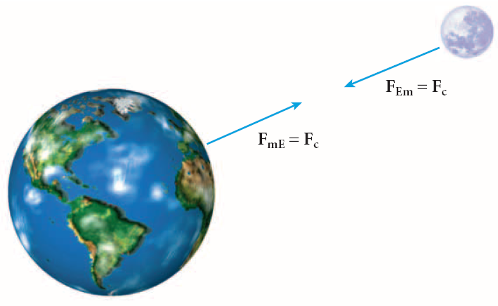
Newton’s Law of Universal Gravitation
Chapter 7

Slide 8
Applying the Law of Gravitation
Chapter 7
Newton’s law of gravitation accounts for ocean tides.
High and low tides are partly due to the gravitational force exerted on Earth by its moon.
The tides result from the difference between the gravitational force at Earth’s surface and at Earth’s center.

Slide 9
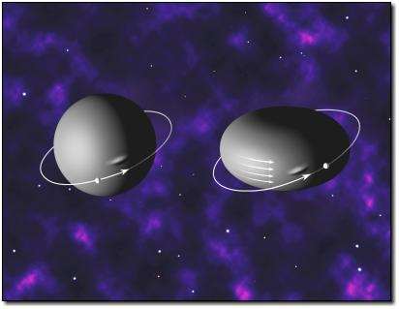
On to Black Holes
Escape velocity!

Slide 10
Escape Velocity
Imagine feebly tossing a rocketship up in the air. It falls back to Earth because its kinetic energy was less than its gravitational potential energy.
However, toss it with a larger and larger velocity and it will go higher and higher before falling back to Earth.
There is a velocity above which it will not return to Earth -- this is the escape velocity.

Slide 11
Escape Velocity
To determine the escape velocity from Earth you set the gravitational potential energy equal to kinetic energy and solve for velocity
Mass of the
object from
which you
want to escape
Radius from which you want to escape

Slide 12
Escape Velocity
Note that the escape velocity doesn’t depend on the mass of the escaping body.
For the Earth, put in the mass and radius of the Earth (for escape from the surface of the Earth) and you get:
V_{esc}= 11 km/sec = 25,000 miles/hr

Slide 13
Escape Velocity
Now suppose you shrink the Earth to 1/100 of its current radius (at constant mass). What happens to V_{esc}?
As R goes up, V_{esc} goes down
As R goes down, V_{esc} goes up
Don’t forget the square root
For this case, V_{esc} increases by 10x

Slide 14
Escape Velocity
Reduce the radius of the Earth to 1cm and
V_{esc}=c (speed of light)
In this new theory of Gravity, where photons are affected by gravity, if the escape velocity equals or exceeds the speed of light, that object can no longer be observed. This is a Black Hole

Slide 15
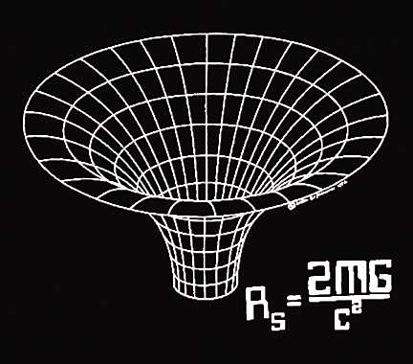
Black Holes
The critical radius for which an object of a particular mass has an escape velocity of `c’ is called the Schwarzschild Radius.
This is also called
the `Event Horizon’.

Slide 16
Schwarzschild Radius
You can easily calculate the Schwarzschild radius for any mass by setting V_{esc}=c
Every object has a radius at which it becomes a Black Hole

Slide 17
Black Holes
But, it is VERY, VERY difficult to compress an object to its Schwarzschild radius.
For the Sun, you would have to somehow overcome thermal pressure, then e- degeneracy, then neutron degeneracy. We know of no `cosmic vice’ that can do that.

Slide 18
Black Hole FAQs
What would happen if the Sun collapsed into a Black Hole, would the Earth be dragged in?
No, the gravitational force at the distance of the Earth would not change.

Slide 19
Is the Event Horizon a physical boundary?
No, it is simply the distance from the center where the escape velocity of `c’.

Slide 20
What happens if a Black Hole absorbs some mass?
As M increases, the Schwarzschild radius also increases.

Slide 21
Is there any reason to believe that Black Holes exist?
You Bet!

Slide 22
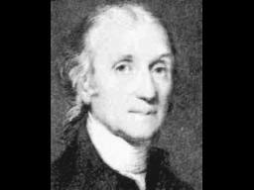
Applying the Law of Gravitation
Chapter 7
Section 2 Newton’s Law of Universal Gravitation
Henry Cavendish applied Newton’s law of
universal gravitation to find the value of
G and Earth’s mass.
When two masses, the distance between them, and the gravitational force are known, Newton’s law of universal gravitation can be used to find G.
Once the value of G is known, the law can be used again to find Earth’s mass.

Slide 23
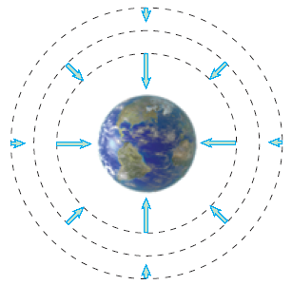
Applying the Law of Gravitation, continued
Chapter 7
Section 2 Newton’s Law of Universal Gravitation
Gravity is a field force.
Gravitational field strength, g, equals F_{g}/m.
The gravitational field, g, is a vector with magnitude g that points in the direction of F_{g}.
Gravitational field strength equals free-fall acceleration.
The gravitational field vectors represent Earth’s gravitational field at each point.

Slide 24
Applying the Law of Gravitation, continued
Chapter 7
Section 2 Newton’s Law of Universal Gravitation
weight = mass × gravitational field strength
Because it depends on gravitational field strength, weight changes with location:
On the surface of any planet, the value of g, as well as your weight, will depend on the planet’s mass and radius.

