Slide 1
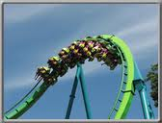
Potential & Kinetic energy

Slide 2
Kinetic Energy
If an object is moving, it has energy. (Be careful, the converse of this statement is not always true!)
This energy is called kinetic energy - the energy of motion.

Slide 3
Kinetic Energy
An object’s kinetic energy depends on:
the object’s mass.
Kinetic energy is directly proportional to mass.
the object’s speed.
Kinetic energy is directly proportional to the square of the object’s speed.

Slide 4
Kinetic Energy
In symbols:
1
KE =
mv²
2

Slide 5
Kinetic Energy
Kinetic energy is a scalar quantity.
Common units of kinetic energy: Joules
An object with mass of 1 kg, moving at 1 m/s, has a kinetic energy of 0.5 Joule.

Slide 6
Potential Energy: Stored up energy that has the possibility of being used.
Which of the following are forms of potential energy?
A Gravitational (height)
B Chemical (batteries)
C Heat (Friction)
D Elastic (Springs or rubber bands)

Slide 7
Potential Energy
Potential Energy
the energy associated with an object because of the position, shape, or condition of the object.
Gravitational potential energy
the potential energy stored in the gravitational fields of interacting bodies.
depends on height from a zero level.
PE_{g} = mgh
gravitational PE = mass × free-fall acceleration × height

Slide 8
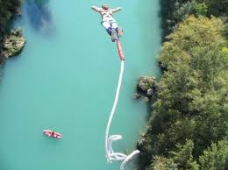
Potential Energy
Elastic potential energy
the energy available for use when a deformed elastic object returns to its original configuration.
The symbol k is called the spring constant, a parameter that measures the spring’s resistance to being compressed or stretched.

Slide 9
Practice Prob
A 70.0 kg stuntman is attached to a bungee cord with an unstretched length of 15.0m. He jumps off a bridge spanning a river from a height of 50.0m When he finally stops, the cord has stretched to a length of 44.0 m. K of bungee cord = 71.8 N/m, what is the total potential energy when the man stops falling?

Slide 10
Potential energy
Examples
Julius Sumner Miller

Slide 11
Assignment
Kinetic Energy - Practice B (pg 166) #1 (You can do 5 if you really want to)
Potential Energy - Practice D (pg 172) 1-3. 3B is challenging ☺

