Slide 1
Waves and Sound
Physics

Slide 2
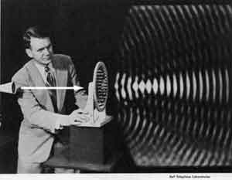

What is a wave
A WAVE is a vibration or disturbance in space.
A MEDIUM is the substance that all SOUND WAVES travel through and need to have in order to move.

Slide 3
Two types of Waves
The first type of wave is called Longitudinal.
Longitudinal Wave - A fixed point will move parallel with the wave motion
2 areas
Compression- an area of high molecular density and pressure
Rarefaction - an area of low molecular density and pressure

Slide 4
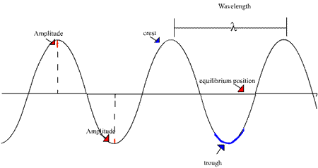
Two types of Waves
The second type of wave is called Transverse.
Transverse Wave - A fixed point will move perpendicular with the wave motion.
Wave parts - crest, trough, wavelength, amplitude, frequency, period

Slide 5
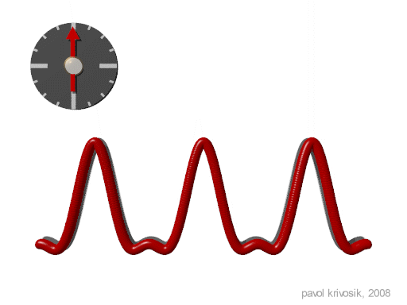
Wave Speed
You can find the speed of a wave by multiplying the wave’s wavelength in meters by the frequency (cycles per second). Since a “cycle” is not a standard unit this gives you meters/second.

Slide 6
Example
A harmonic wave is traveling along a rope. It is observed that the oscillator that generates the wave completes 40.0 vibrations in 30.0 s. Also, a given maximum travels 425 cm along a rope in 10.0 s . What is the wavelength?
0.0319 m/s

Slide 7
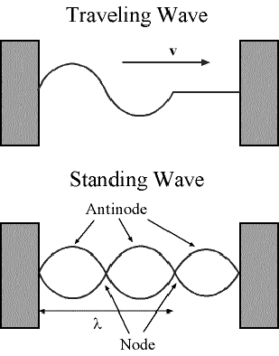
Standing Waves
A standing wave is produced when a wave that is traveling is reflected back upon itself. There are two main parts to a standing wave:
Antinodes – Areas of MAXIMUM AMPLITUDE
Nodes – Areas of ZERO AMPLITUDE.

Slide 8
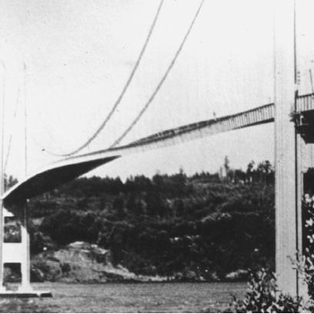
Sound Waves
Sound Waves are a common type of standing wave as they are caused by RESONANCE.
Resonance – when a FORCED vibration matches an object’s natural frequency thus producing vibration, sound, or even damage.
One example of this involves shattering a wine glass by hitting a musical note that is on the same frequency as the natural frequency of the glass. (Natural frequency depends on the size, shape, and composition of the object in question.) Because the frequencies resonate, or are in sync with one another, maximum energy transfer is possible.

Slide 9
Sound Waves
The production of sound involves setting up a wave in air. To set up a CONTINUOUS sound you will need to set a standing wave pattern.
Three LARGE CLASSES of instruments
Stringed - standing wave is set up in a tightly stretched string
Percussion - standing wave is produced by the vibration of solid objects
Wind - standing wave is set up in a column of air that is either OPEN or CLOSED
Factors that influence the speed of sound:
density of solids or liquid
TEMPERATURE

Slide 10
Closed Pipes
Have an antinode at one end and a node at the other. Each sound you hear will occur when an antinode appears at the top of the pipe. What is the SMALLEST length of pipe you can have to hear a sound?
You get your first sound or encounter your first antinode when the length of the actual pipe is equal to a quarter of a wavelength.
This FIRST SOUND is called the FUNDAMENTAL FREQUENCY or the FIRST HARMONIC.

Slide 11
Closed Pipes - Harmonics
Harmonics are MULTIPLES of the fundamental frequency.
In a closed pipe, you have a NODE at the 2nd harmonic position, therefore NO
SOUND is produced

Slide 12
Closed Pipes - Harmonics
In a closed pipe you have an ANTINODE at the 3rd harmonic position, therefore SOUND is produced.
CONCLUSION: Sounds in CLOSED pipes are produced ONLY at ODD HARMONICS!

Slide 13
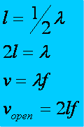
Open Pipes
OPEN PIPES- have an antinode on BOTH ends of the tube. What is the SMALLEST length of pipe you can have to hear a sound?
You will get your FIRST sound when the length of the pipe equals one-half of a
wavelength.

Slide 14
Open Pipes - Harmonics
Since harmonics are MULTIPLES of the fundamental, the second harmonic of an “open pipe” will be ONE WAVELENGTH.
The picture above is the SECOND harmonic or the FIRST OVERTONE.

Slide 15
Open pipes - Harmonics
Another half of a wavelength would ALSO produce an antinode on BOTH ends. In fact, no matter how many halves you add you will always have an antinode on the ends
The picture above is the THIRD harmonic or the SECOND OVERTONE.
CONCLUSION: Sounds in OPEN pipes are produced at ALL HARMONICS!

Slide 16
Example
The speed of sound waves in air is found to be 340 m/s. Determine the fundamental frequency (1st harmonic) of an open-end air column which has a length of 67.5 cm.
251.85 HZ

Slide 17
Example
The windpipe of a typical whooping crane is about 1.525-m long. What is the lowest resonant frequency of this pipe assuming it is a pipe closed at one end? Assume a temperature of 37°C.
353.2 m/s
57.90 Hz

