Slide 1
Simple Harmonic Motion

Slide 2
Simple Pendulum
Simple pendulum –
Consists of a mass (called a bob) that is attached to a fixed string;
Assume that:
the mass of the bob is concentrated at a point at the center of mass of the bob
the mass of the string is negligible;
disregard friction and air resistance

Slide 3
Simple Pendulum

Slide 4
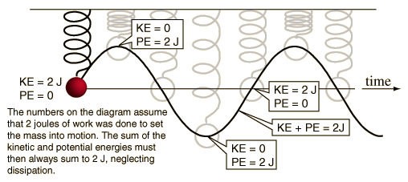
Conservation of energy in Springs
For small amplitude angles (less than 15°), a pendulum exhibits SHM
At maximum displacement from equilibrium, a pendulum bob has maximum potential energy; at equilibrium, this PE has been converted to KE
Amplitude – the maximum displacement from equilibrium

Slide 5
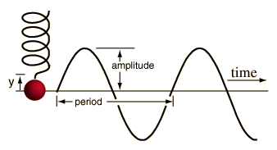
Springs are like Waves and Circles
The amplitude, A, of a wave is the same as the displacement ,x, of a spring. Both are in meters.
CREST
Equilibrium Line
Trough
Period, T, is the time for one revolution or in the case of springs the time for ONE COMPLETE oscillation (One crest and trough). Oscillations could also be called vibrations and cycles. In the wave above we have 1.75 cycles or waves or vibrations or oscillations.
T_{s}=sec/cycle. Let’s assume that the wave crosses the equilibrium line in one second intervals. T =3.5 seconds/1.75 cycles. T = 2 sec.

Slide 6
Period and Frequency
period (T) – the time, in seconds, to execute one complete cycle of motion; units are seconds per 1 cycle
frequency (f) – the number of complete cycles of motion that occur in one second; units are cycles per 1 second (also called hertz)

Slide 7
Frequency and period
The FREQUENCY of a wave is the inverse of the PERIOD. That means that the frequency is the #cycles per sec. The commonly used unit is HERTZ(HZ).

Slide 8
Period of a Simple Pendulum
notice that only length of the string and the value for free-fall acceleration affect the period of the pendulum; period is independent of the mass of the bob or the amplitude

Slide 9
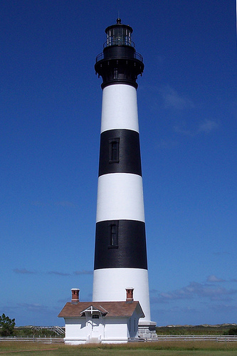
Example
A visitor to a lighthouse wishes to determine the height of the tower. She ties a spool of thread to a small rock to make a simple pendulum, which she hangs down the center of a spiral staircase of the tower. The period of oscillation is 9.40 s. What is the height of the tower?
L = Height = 21.93 m

Slide 10
Period of a Mass-Spring System
period of a mass-spring system depends on mass and the spring constant
notice that only the mass and the spring constant affect the period of a spring; period is independent of amplitude (only for springs that obey Hooke’s Law)

Slide 11
Comparison of a Pendulum and an Oscillating Spring

