Slide 1
Work, Energy and Power

Slide 2
This Weeks Plan
Mon: Definition of Work, W = F•d, Energy
Tues: Types of energy: Kinetic, Ke=1/2mv^2
Wed: Types of energy: Potential,
Gravitational: Pe = mgh, Spring: 1/2kx^2
-Quiz on Monday’s material
Thurs: Conservation of Energy
Fri: Misc. (friction -> Heat, chemical potential)
-Quiz on Kinetic and Potential Energy

Slide 3
Work
What is work?
Working at a job
Pushing a car
Picking up a weight
Holding a weight up

Slide 4
Work
Work in physics is what we might refer to as effort.
Pushing a car (Work)
Picking up a weight (Work)
Holding a weight up (Not work)

Slide 5
Holding a weight up is not work because it can be done by a passive object.
A table can hold the weight up with no effort.
- Do I do work when I push on the wall?
A Yes, you are expending effort and tiring yourself out.
B No; if you lean an object against the wall it will push against the wall but not expend effort.

Slide 6
Work: W = F•d
In physics, the way we measure work is taking the dot-product of the Force and distance vectors: W = F•d
A dot-product is the multiplication of co-linear components. W = (Fx x dx) + (Fy x dy)
i.e. Multiply the x components (Fx x dx)

Slide 7
W = F•d
What is the work if:
The force on the box is 10 Newtons
The distance pushed is 5 meters

Slide 8
W = F•d
What is the work if:
The force on the box is 10 Newtons
The distance pushed is 5 meters
W = Fx x dx
W = 10 x 5 = 50 J

Slide 9
Work = F x cosθ x d
W = Fx x dx = F x cosθ x d
What is the work if:
The force on the box is 8 Newtons
The distance pushed is 2 meters
The angle is 30 degrees

Slide 10
Work = F x cosθ x d
W = Fx x dx = F x cosθ x d
What is the work if:
The force on the box is 8 Newtons
The distance pushed is 2 meters
The angle is 30 degrees
W = 8 x cos(30) x 2 = 13.86 kg * m^2 / s^2

Slide 11
Units of Work
Work = Fx x dx = F x cosθ x d
What are the SI units for Work?
A m/s^2
B kg * m^2 / s^2
C N * m/s^2

Slide 12
Work is measured in Joules
Joules are the unit of energy

Slide 13
Work Homework
Chapter 5 Homework Practice A 1-4
Pg 162

Slide 14
Tuesday Jan. 31
Similarities between
Work-Energy and Impulse-Momentum
Types of energy: Kinetic Energy
Ke=1/2mv²

Slide 15
Work-Energy and Impulse-Momentum
Work changes the energy of an object in the same way that impulse changes the momentum of an object.
I = Δp = p_{f} - p₀
p₀ + I = p_{f}
Recall the cart problem (Problem 2a) from the test:
Cart A, initially at rest is pushed with a force of 5N for 10 seconds.

Slide 16
Work-Energy and Impulse-Momentum
Work and Energy work in the same way.
W = ΔE
E₀ + W = E_{f}

Slide 17
We’ve talked about work.
W = F•d = Fdcosθ
and I’ve mentioned that the units of work are J
Now lets look at one of the forms this energy can take: Kinetic energy
(Kinematic = motion,
think kinematic equations, laws of motion)

Slide 18
Derivation of Kinetic Energy (linear)
Work = Fd
F= ma
Work = mad
V_{f}² = V_{i}² + 2ad → ad = V_{f}²/2 - V_{i}² /2
Work = ½ mV_{f}² – ½ mV_{i}²
Ke = ½ mV_{f}²

Slide 19
Ke = ½ mv²
What is the kinetic energy of a train car (mass
67,132 kg) travelling at 30km/hour?

Slide 20
Ke = ½ mv²
What is the kinetic energy of a train car (mass
67,132 kg) travelling at 30km/hour?
30km/hour = 30*1000/3600 m/s = 8.333m/s
Ke = ½ mv²
= ½ *67132*8.333² = 2,330,972 J
= 2,330 kJ

Slide 21
Trickier problem
Trains take a long time to come to a stop.
The train car from the previous problem starts breaking 1 km before a train station.
What is the force that the breaks must apply to stop the train in time?

Slide 22
The train car from the previous problem starts breaking 1 km before a train station. What is the force that the breaks must apply to stop the train in time?
The energy of the train car from before was 2,330 kJ.
The breaks need do negative work on the train car to remove this kinetic energy.
Final kinetic energy = 0 (the train car stops)
E₀ + W = E_{f}
2330kJ + W = 0
W = F • d = Fdcosθ = -2330kJ d=1000m θ = 0
F = 2,330 N

Slide 23
F = 2,330 N
This is roughly the force of 3 people standing on you.
3mg = 3(70kg * 9.8m/s^2) = 2058 N
Trains are very hard to stop.
Is this energy lost?

Slide 24
One more problem
A car (750 kg) on flat ground increases it’s velocity from 20m/s to 30m/s. What was the work done by its engine?

Slide 25
One more problem
A car (750 kg) on flat ground increases it’s velocity from 20m/s to 30m/s. What was the work done by its engine?
Ke₀ = ½ mv₀² = ½ x 750 x 20² = 150,000 J
Ke_{f} = ½ mv_{f}² = ½ x 750 x 30² = 337,500 J
W = ΔE = 337,500 – 150,000 = 187,500 J

Slide 26
Conceptual Question
Compare the energy required to accelerate a car from Case 1 Case 2
0 to 10mph 20mph to 30mph
A E_{case1} = E_{case2}
B E_{case1} > E_{case2}
C E_{case1} < E_{case2}
D You can’t solve with the given information
Z No idea

Slide 27
Quiz tomorrow on Work
HW due tomorrow on Kinetic Energy

Slide 28
Potential Energy
Potential Energy: Stored up energy that has the possibility of being used.
Which of the following are forms of potential energy?
A Gravitational (height)
B Chemical (batteries)
C Heat (Friction)
D Elastic (Springs or rubber bands)

Slide 29
Potential Energy
Potential Energy: Stored up energy that has the possibility of being used.
Which of the following are forms of potential energy?
A Gravitational (height) potential energy
B Chemical (batteries) potential energy
C Heat (Friction) heat
D Elastic (Springs or rubber bands) potential energy

Slide 30
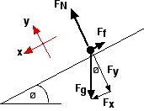
Derivation Gravitational Potential Energy (near Earth’s surface)
W = F•d
Fgravity = mg
Work due to gravity = mg•d
Work = mgh

Slide 31
A rollercoaster cart slowly crests a the top of a 72m track. It then travels down the track until it reaches ground level.
How fast is it going when it reaches ground level?

Slide 32
A rollercoaster cart slowly crests a the top of a 72m track. It then travels down the track until it reaches ground level.
How fast is it going when it reaches ground level?

Slide 34
Conservation of Energy
As shown in the previous example, a loss in Pe often leads to a gain in Ke, leaving the total energy constant.
You might guess that energy is conserved
(and it is)

Slide 35
Parallels between Momentum and Energy
Earlier we showed that the momentum-impulse relationship was very similar to that of energy-work. This applies to conservation as well.
Momentum was conserved if no forces from outside the system exerted an impulse.
Energy is conserved if there is no work done on the system by outside forces.

Slide 36
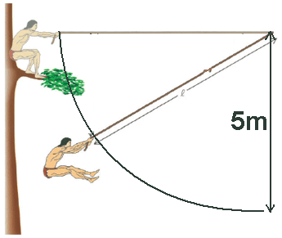
Example problem
Tarzan jumps out of a tree (from 5 meters up) , grabbing a vine on his way down and swinging.
What is his velocity at the bottom of his swing?

Slide 37
Tarzan falls out of a tree (from 5 meters up) , grabbing a vine on his way down and swinging.
What is his velocity at the bottom of his swing?
First question: can we use conservation of energy?
Is there work done on the system from outside?

Slide 38
Tarzan falls out of a tree (from 5 meters up) , grabbing a vine on his way down and swinging.
What is his velocity at the bottom of his swing?
There is no work done on the system from outside because the force of the vine is always perpendicular to the distance being travelled.

Slide 39
Tarzan falls out of a tree (from 5 meters up) , grabbing a vine on his way down and swinging.
What is his velocity at the bottom of his swing?
E₀ + W = E_{f} but W=0 therefore E₀ = E_{f}
E₀ = Ke₀ + Pe₀ = ½ mv₀² + mgh₀
E_{f} = Ke_{f} + Pe_{f} = ½ mv_{f}² + mgh_{f}
Ke₀ = 0
Pe_{f} = 0
mgh₀ = ½ mv_{f}²
v_{f} = (2gh₀)^.5 = 9.89 m/s

Slide 40
Tarzan falls out of a tree (from 5 meters up) , grabbing a vine on his way down and swinging.
What is his velocity at the bottom of his swing?
v_{f} = 9.89 m/s
What would his velocity be if he were in freefall for that distance?

Slide 41
Additional Problems
A student throws a ball upward where the initial potential energy is 0.
At a height of 15 meters the ball has a potential energy of 60 joules and is moving upward with a kinetic energy of 40 joules.
Ignoring air resistance, the maximum height achieved by the ball is most nearly:
10 m (B) 20 m (C) 25 m
(D) 30 m (E) 40 m

Slide 42
Additional Problems
A 3 m long frictionless pendulum of swings with an amplitude of 10°. At its equilibrium position the kinetic energy of the pendulum is 20 J. What is the potential energy of the pendulum when the kinetic energy is 5 J?
(A) 3.3 J (B) 5 J (C) 6.7 J
(D) 10 J (E) 15 J

Slide 43
Continuing Energy Conservation

Slide 44
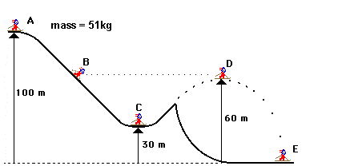
How much kinetic and potential energy does the skier have at each point?

Slide 45
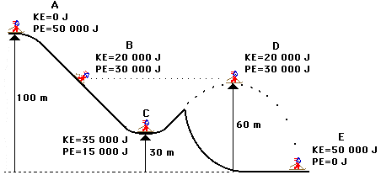
How fast is the skier going at each point?

Slide 46
How fast is the skier going at each point?
A 0 = ½ mv² = ½ 51 * v² v = 0
B 20,000 = ½ 51 * v² v = 28 m/s
C 35,000 = ½ 51 * v² v = 37 m/s
D 20,000 = ½ 51 * v² v = 28 m/s
E 50,000 = ½ 51 * v² v = 44.3 m/s

Slide 47
A 2 kg block released from rest from the top of an incline plane. There is no friction between the block and the surface.
How much work is done by the gravitational force on the block?
80 J (B) 60 J (C) 50 J (D) 40 J (E) 30 J
What is the speed of the block when it reaches the horizontal surface?
3.2 m/s (B) 4.3 m/s (C) 5.8 m/s
(D) 7.7 m/s (E) 6.6 m/s

Slide 48
A 2 kg block released from rest from the top of an incline plane. There is no friction between the block and the surface.
How much work is done by the gravitational force on the block?
80 J (B) 60 J (C) 50 J (D) 40 J (E) 30 J
What is the speed of the block when it reaches the horizontal surface?
3.2 m/s (B) 4.3 m/s (C) 5.8 m/s
(D) 7.7 m/s (E) 6.6 m/s

Slide 49
Integrating Topics
Ball A (2kg) is initially moving with a velocity of 4m/s and collides elastically with ball B of equal mass that is at rest.
Find the final velocities of the balls.

Slide 50
Integrating Topics
Ball A (2kg) is initially moving with a velocity of 4m/s and collides elastically with ball B of equal mass that is at rest.
Find the final velocities of the balls.
Elastic means Energy is conserved
½ m₁v_{1i}² = ½ m₁v_{1f}² + ½ m₂v_{2f}²
Momentum is conserved because there are no outside forces
m₁v_{1i} = m₁v_{1f} + m₂v_{2f}

Slide 51
Integrating Topics
Ball A (2kg) is initially moving with a velocity of 4m/s and collides elastically with ball B of equal mass that is at rest.
Find the final velocities of the balls.
½ m₁v_{1i}² = ½ m₁v_{1f}² + ½ m₂v_{2f}²
½ 2x4² = ½ 2v_{1f}² + ½ 2v_{2f}²
16 = v_{1f}² + v_{2f}²
m₁v_{1i} = m₁v_{1f} + m₂v_{2f}
2x4 = 2v_{1f} + 2v_{2f}
v_{2f} = 4-v_{1f}
Plugging equation 2 into equation 1:
16 = v_{1f}² + (4-v_{1f})²
16 = v_{1f}² + 16 - 8v_{1f} + v_{1f}²
0 = 2v_{1f}² - 8v_{1f}
v_{1f} = 4 or 0

Slide 52
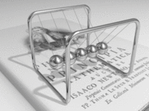
Newton’s Cradle

Slide 53
Why does only one ball go up? Why not 2?
Lets look at the conservation of energy and momentum

Slide 54
Energy Conservation
½ mv_{1i}² = ½ (2m)v_{2f}²
½ v_{1i}² = v_{2f}²
v_{2f} = (½v_{1i})^{0.5}
Momentum Conservation
mv_{1i} = 2mv_{2f}
v_{1i} = 2v_{2f}
v_{1i} =? 2 (½v_{1i})^{0.5}
There is no way for momentum and energy to be conserved at the same time if 2 balls go up

Slide 55
Review/Practice Week
When can I use energy conservation?
Heat
Friction
Power = Work/Time

Slide 56
Limitations of Energy Conservation
Energy is always conserved if we consider all forms of energy.
However some forms of energy are very hard to measure, especially energy “lost” through friction, heat or sound.
When most physicists talk about energy conservation, they are referring to easily measured forms, Kinetic and Potential.

Slide 57
Consider two carts with magnets, for example in our lab. Pushed carts toward each other and in the collision they bounced. It turns out this was an elastic collision
½ m₁v_{1i}² + ½ m₂v_{2i}² = ½ m₁v_{1f}² + ½ m₂v_{2f}²
What if they don’t bounce? Think of a car crash
½ m₁v_{1i}² + ½ m₂v_{2i}² = 0 ?

Slide 58
What if they don’t bounce? Think of a car crash
½ m₁v_{1i}² + ½ m₂v_{2i}² = ΔQ + γ + W_{S}?

Slide 59
We did not consider the energy that went into heat or sound.
This is considered to be a case in which energy is not conserved because the energy did not stay as kinetic or potential energy.
Energy is still conserved if we consider all forms of energy!

Slide 60
If I take a stapler and slide it across a table, it comes to a stop fairly quickly. This is due to friction.
Energy lost due to friction is easier to calculate because the force of friction is not difficult to measure.

Slide 61
A block of mass m = 50 kg moves on a rough horizontal surface. Friction applies a force of 250N. The traveled distance is 20 m. How much work is done by the friction force?
A. 1000 J B. 2000 J C. 3000 J
D. 4000 J E. -5000 J

Slide 62
A block of mass m = 50 kg moves on a rough horizontal surface. Friction applies a force of 250N. The traveled distance is 20 m. How much work is done by the friction force?
A. 1000 J B. 2000 J C. 3000 J
D. 4000 J E. -5000 J
W = F • d = F cos(0) x d = -250 x 1 x 20 = -5000

Slide 63
Introduction to Friction
Objects generally slow down over time as a result of friction. This is because the force of friction normally opposes the motion of an object.
The force of friction depends on two factors, the normal force (the force of the surface on the object) and the coefficient of friction (μ)
F_{F} = μ x N

Slide 64
Introduction to Friction
F_{F} = μ x N
μ quantifies how “grippy” the surface is.
A car tire on asphalt has a μ of around .7.
A ski on snow has a coefficient of friction of around .05

Slide 65
A worker pushes a 50 kg crate a distance of 7.5 m across a level floor. He pushes it at a constant speed by applying a constant horizontal force. The coefficient of kinetic friction between the crate and the floor is 0.15.
How much work does he do?

Slide 66
A worker pushes a 50 kg crate a distance of 7.5 m across a level floor. He pushes it at a constant speed by applying a constant horizontal force. The coefficient of kinetic friction between the crate and the floor is 0.15.
How much work does he do?
W = F • d = F cos(0) x d
F_{F} = μ x N
N = mg
F_{F} = μ x mg
W = F • d = F cos(0) x d = μ x mg x d =
W = .15 x 50 x 9.8 x 7.5 = 551.25J

Slide 67
Two Main Categories of Friction
Static friction is the friction of a stationary object.
Kinetic friction is the friction on a moving object.
The equation for friction remains the same except for the coefficient of friction.
μ_{s} : coefficient of static friction
μ_{k} : coefficient of kinetic friction

Slide 68
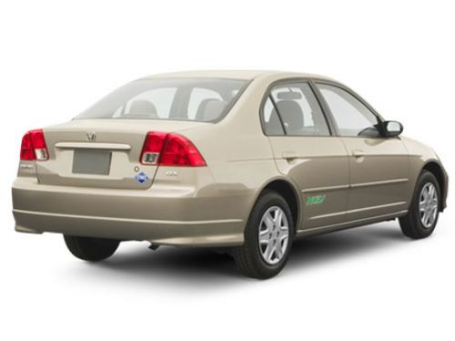
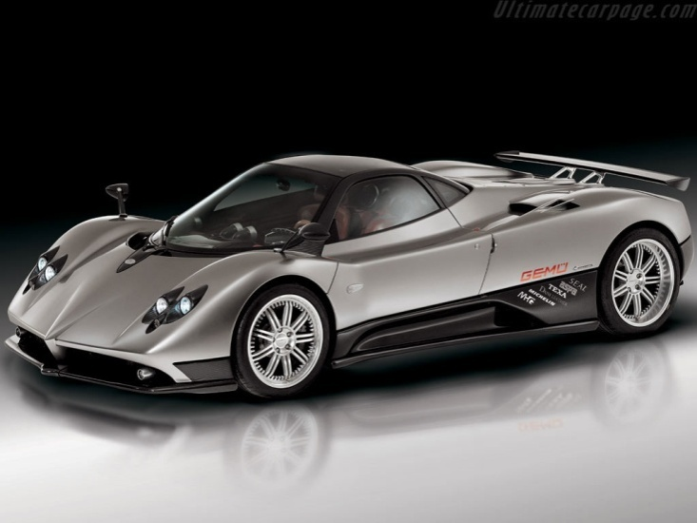
Power
A Honda Civic(1100 kg) accelerates from 0 to 60 in 7.2 seconds.
A McLaren F1 (same mass) accelerates from 0 to 60 in 2.6 seconds.
Which engine does more work?

Slide 69
Power
Using energy conservation we know that the work done by the engine is the same in both cases:
E₀ + W = E_{f}
0 + W = ½ m₁ x 60²
0 + W = ½ m₂ x 60²
m₁ = m₂ = 1100 kg

Slide 70
E0 + Work = Ef
0 + W= ½ mv_{f}² = ½ x 1100 x 26.8² = 15800 J
So what’s the difference between the two cars?
Why would anyone pay for a McLaren F1?

Slide 71
So what’s the difference between the two cars?
Why would anyone pay for a McLaren F1?
The Mclaren F1 is more fun to drive because it’s more powerful.
What is the formula for power?

Slide 72
P = Work/Time
A Honda Civic (1100 kg) accelerates from 0 to 60 in 7.2 seconds.
A McLaren F1 (same mass) accelerates from 0 to 60 in 2.6 seconds.
What is the power of Honda Civic?
What is the power of McLaren F1?

Slide 73
P = Work/Time
A Honda Civic (1100 kg) accelerates from
0 to 60 mph in 7.2 seconds.
P = W / t v_{f} = 60mph = 26.8 m/s
P = 15800 J / 7.2s = 2194 J/s
A McLaren F1 (same mass) accelerates from
0 to 60mph in 2.6 seconds.
P = 15800 J / 2.6s = 6077 J/s

Slide 74
There is a special name for Joules/second:
Watts
Power = W/t =
Joules/second = Watts
Think of a 60 Watt light bulb. It uses 60 Joules every second.

Slide 75
Wrapping up Energy
So far we’ve talked about
Work
Linear kinetic energy
Gravitational potential
Heat (Energy lost to friction)
Conservation of Energy (and input of work)
Power

Slide 76
Other Types of Energy
Kinetic Energy
Rotational Kinetic Energy
Potential Energy
Elastic (springs)
Chemical (batteries)
Electrical (capacitors)
Nuclear (fission, fusion)
Light
Heat

Slide 77
We will be covering
Kinetic Energy
Rotational Kinetic Energy
Potential Energy
Springs (now)
Chemical (batteries)
Electrical (capacitors)
Nuclear (fission, fusion)
Light
Heat

Slide 78
Introduction to Springs
Springs pull harder the further you stretch them.
The force due to a spring is F = -kx
Where k is the spring constant and x is the distance from equilibrium that the spring is stretched or compressed.
F = -kx is known as Hooke’s law
Example: What is the force applied by a spring with spring constant 10 N/m when it is stretched 30cm?
F = - kx = -10 x .3 = -3 N

Slide 79
What is the force of the spring on the box?

Slide 80
Introduction to Springs
The energy stored up in a spring is the integral of F over distance.
You may take as given that the potential energy stored in a spring is ½ kx²
Example
A box (5kg) on a frictionless table compresses a spring (k = 20N/m) a distance of 20cm. After the spring is released, what is the velocity of the box?

Slide 81
Spring Example
A box (5kg) on a frictionless table compresses a spring (k = 20N/m) a distance of 30cm. After the spring is released, what is the velocity of the box? Pe + Ke = Pe + Ke
½ kx² = ½ mv²
½ x 20 x .3² = ½ x 5 x v²
v = .6 m/s

Slide 82
Board Example
Trampoline:
I have 3 feet of room under my trampoline.
The trampoline has an equivalent spring constant of 2000N/m
How high can I jump on my trampoline before I have to worry about hitting the ground underneath?
How high can my heavier friend (70kg) jump?

Slide 83
How far does the ball go?
What is it’s velocity when it hits the ground?
I’ve almost always given numbers, but I don’t have to!

Slide 84
Just use your equations exactly the same way you would normally, leaving the variables in place of numbers.

Slide 85
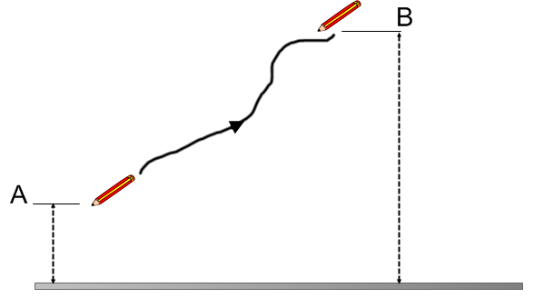
A pencil is moved from point A to point B along a curved path. The work done by the gravitational force on the pencil depends on which of the following:
the velocity of the object as it moves between A and B
(B) the positions of points A and B
(C) the path taken between A and B
(D) both the positions of A and B and the path taken between them
(E) the nature of the external force that moves the object from A to B

Slide 86
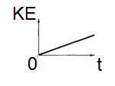
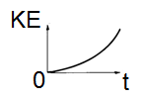
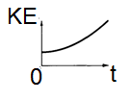
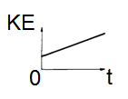
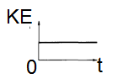
A stone is dropped from the edge of a cliff. Which of the following graphs best represents the stone's kinetic energy KE as a function of time t?
(A) (B) (C)
(D) (E)

Slide 87
A man lifts a mass m at constant speed to a height h in time t. How much work is done by the weight lifter?
(A) mgt (B) zero (C) mgh
(D) mgh/t (E) cannot be determined

Slide 88
A small cube moves at a constant velocity v = 8.5 m/s on the smooth horizontal floor until it reaches the bottom of an inclined plane at θ = 37 ̊above the horizontal. The cube slides up the inclined plane and covers a distance L = 2 m before leaving the incline.
a) Calculate the velocity of the cube at the end of the inclined plane.
b) Find the distance from the base of the inclined plane where the cube hits the floor.
c) If the friction is not ignored, how would it change the answers to (a) and (b)?

